Slide 1

Measuring biodiversity its change
Modelling species distribution and biodiversity patterns
MLU 2021
shane.blowes@idiv.de

Slide 2
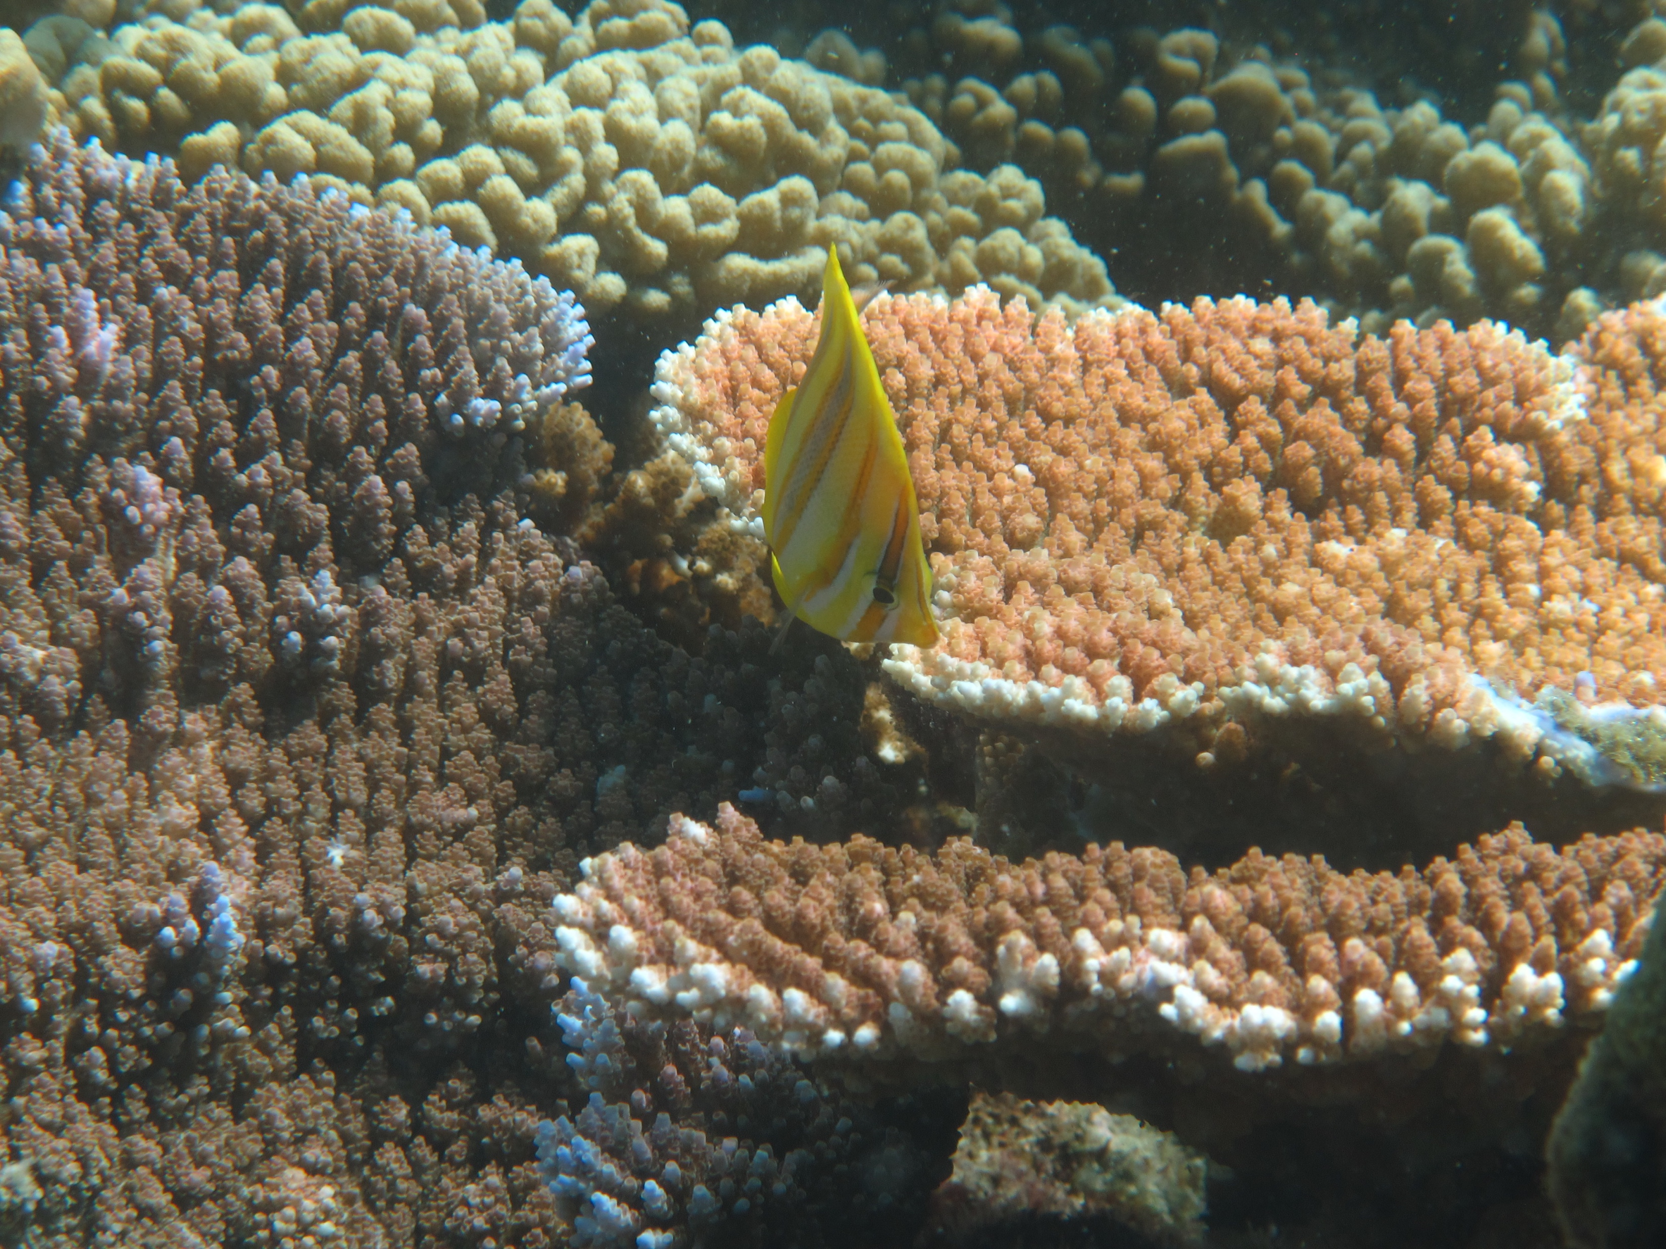
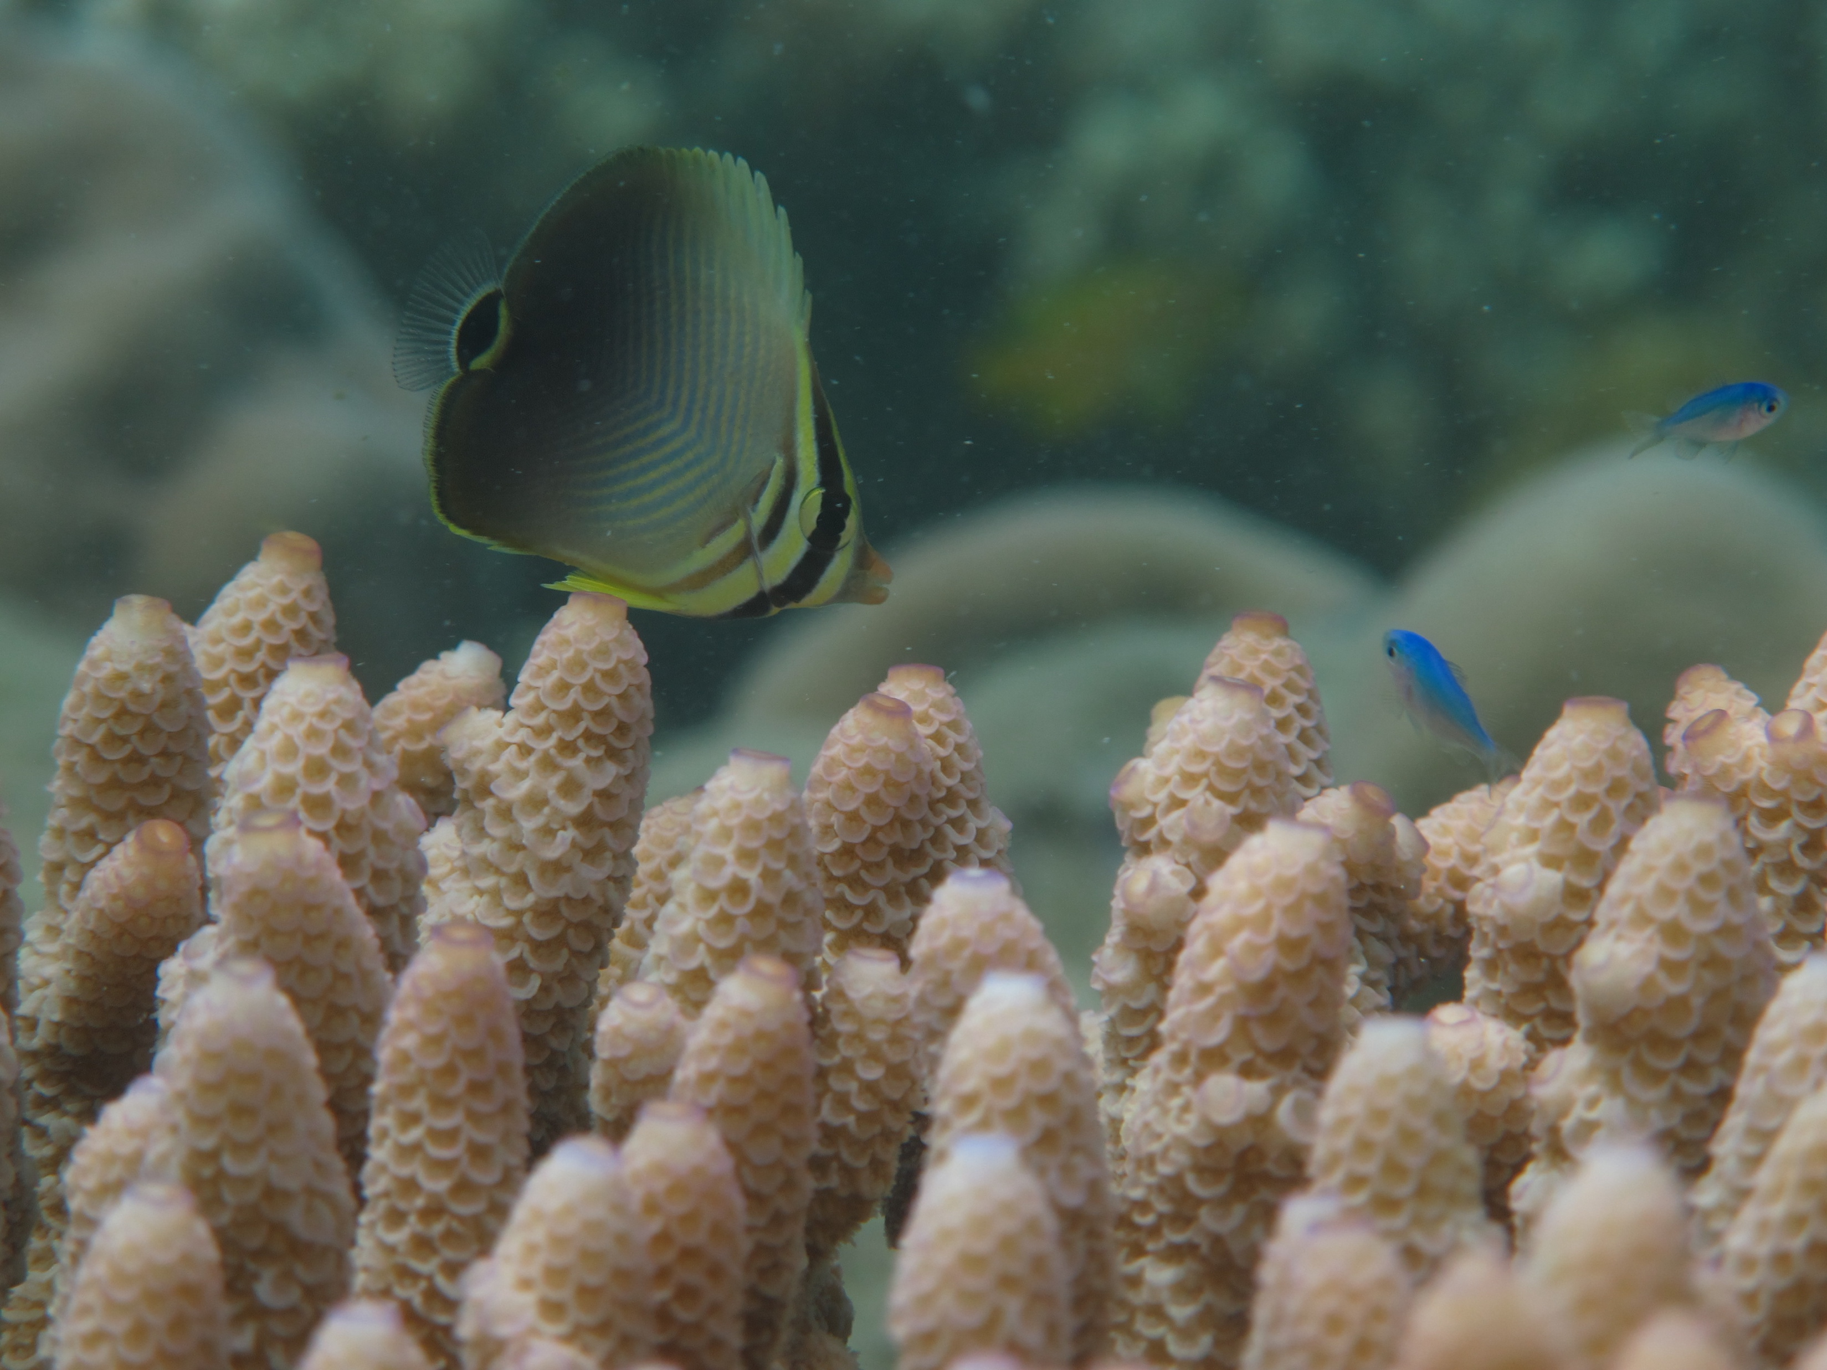
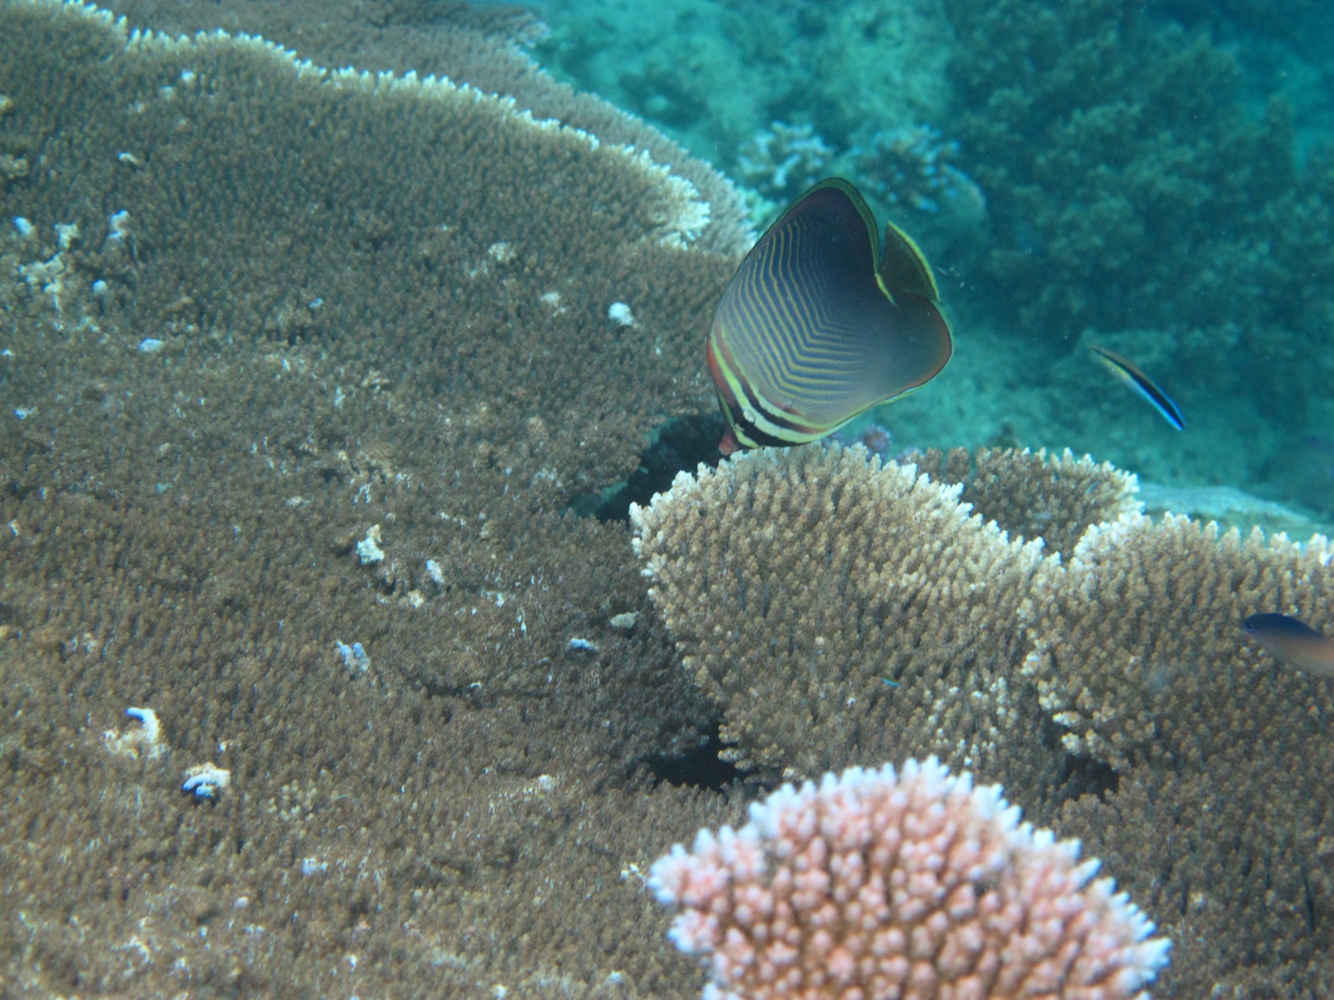
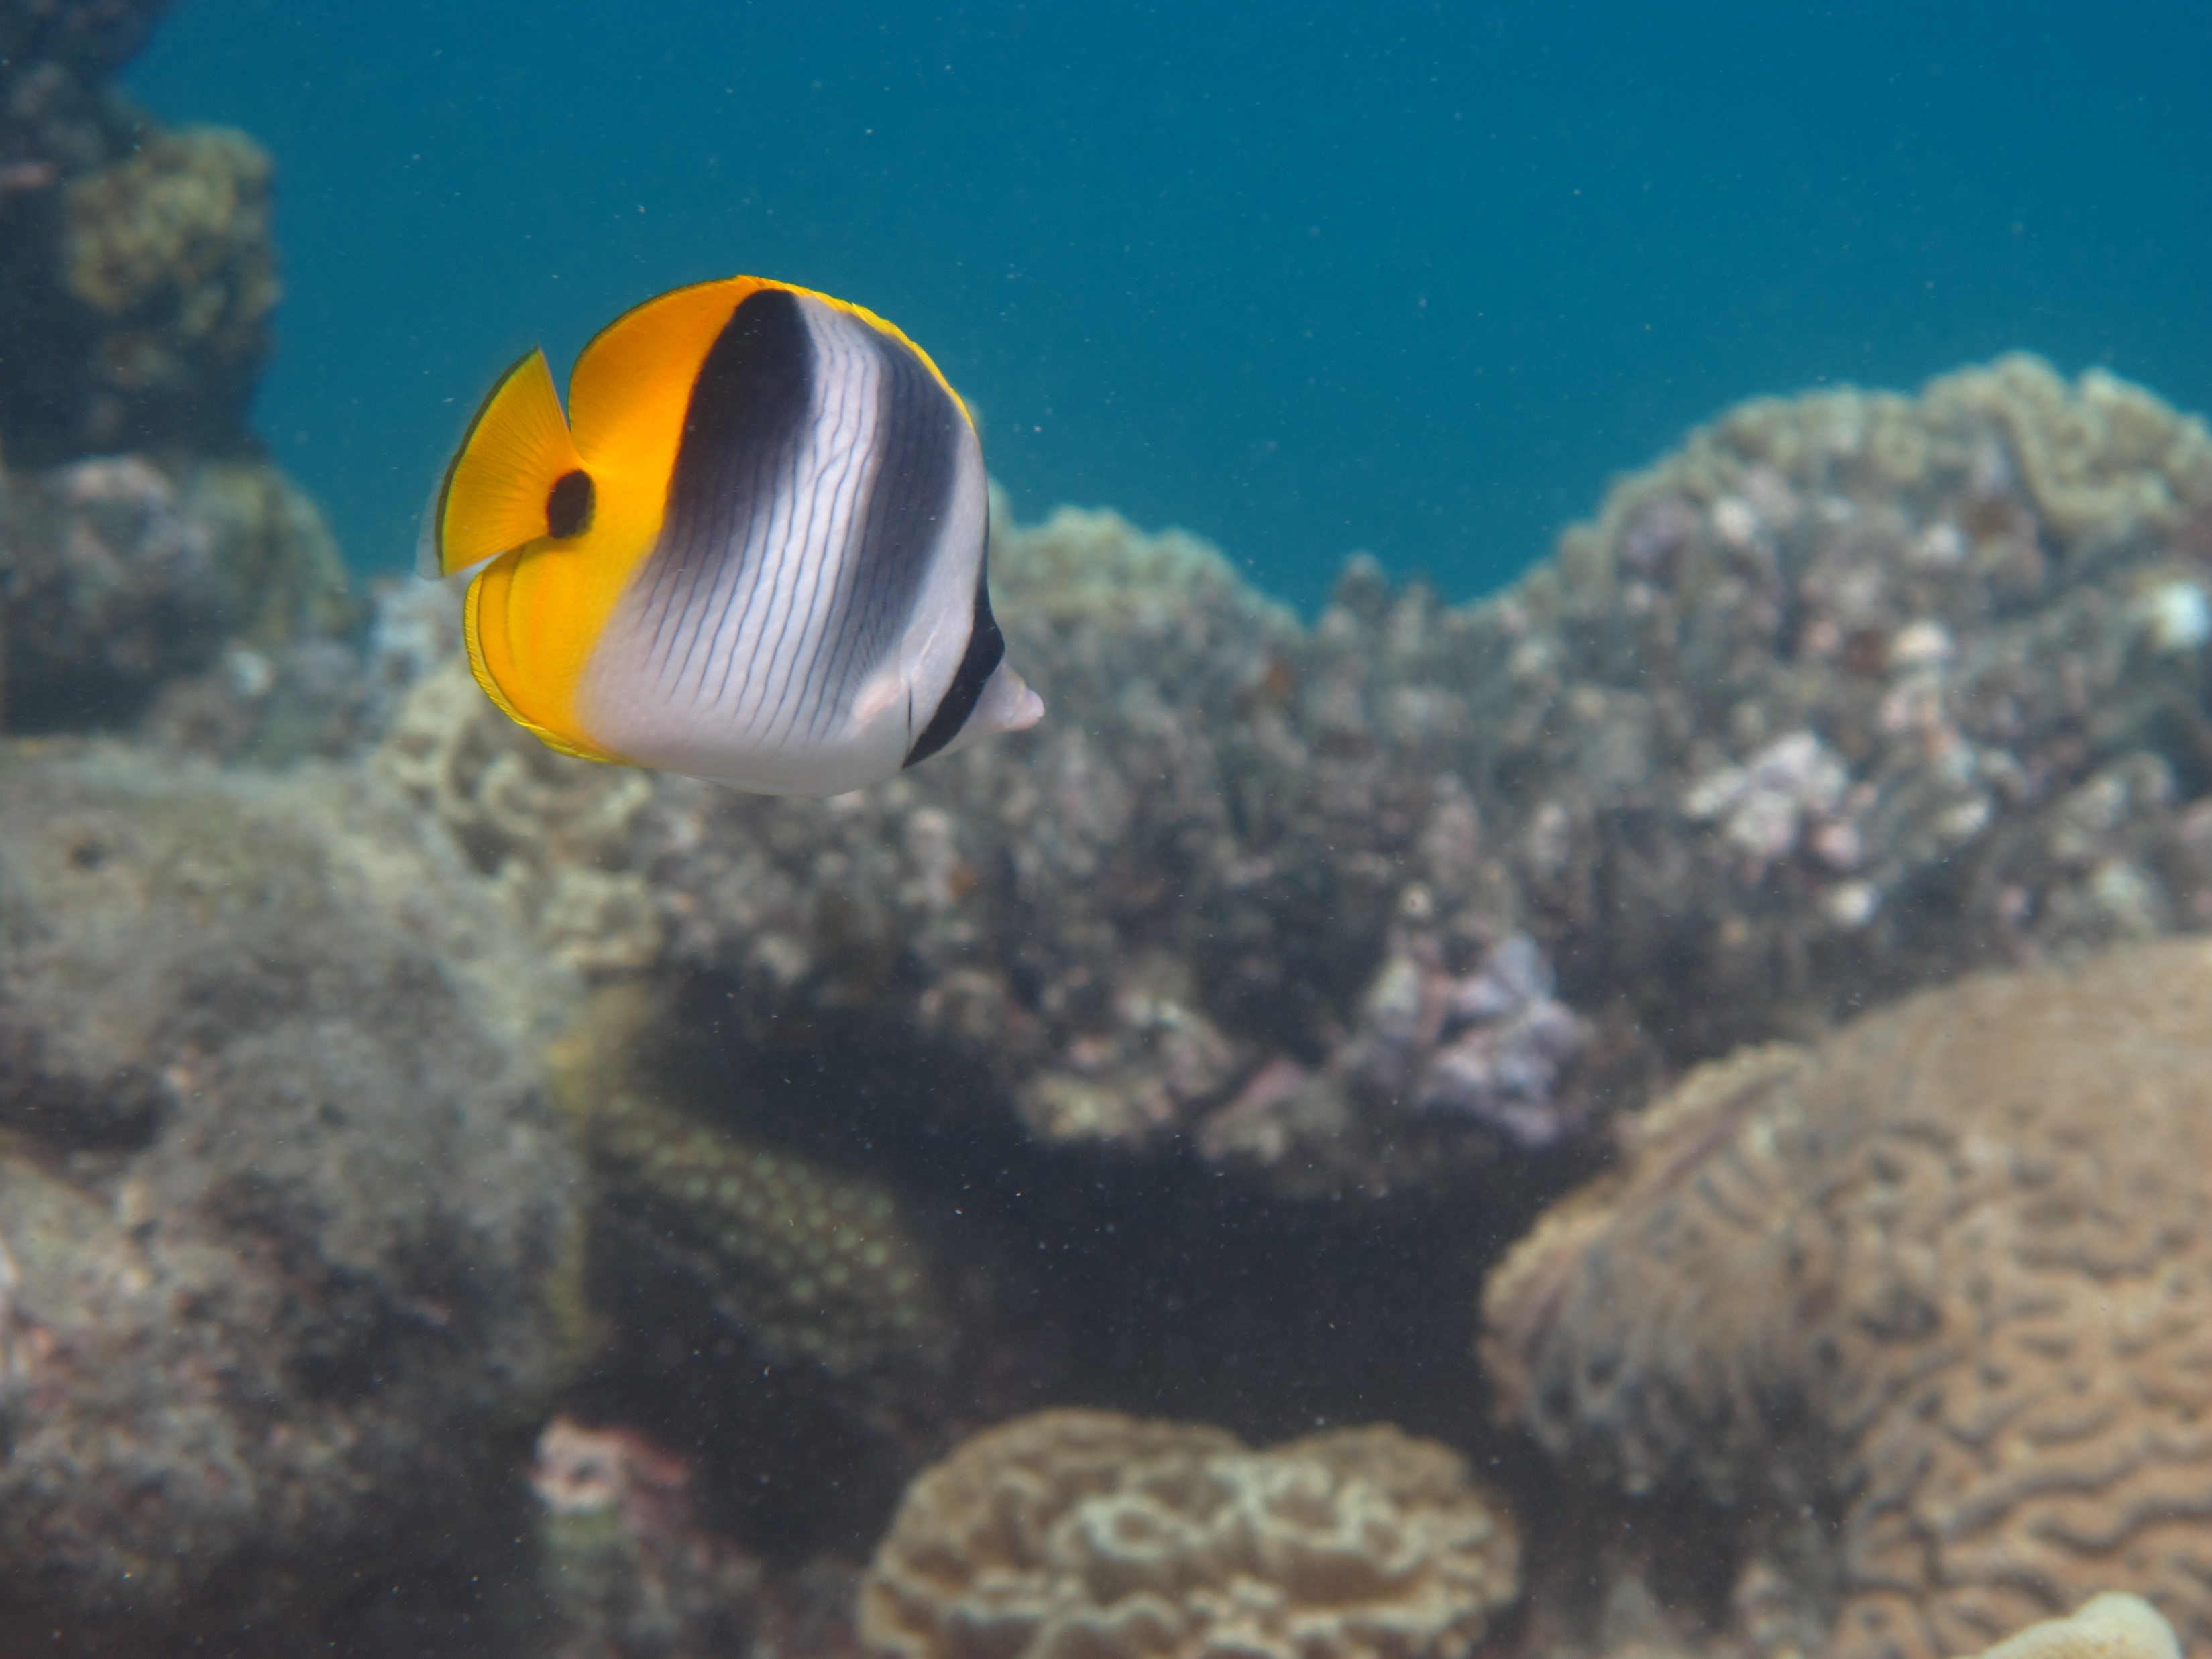
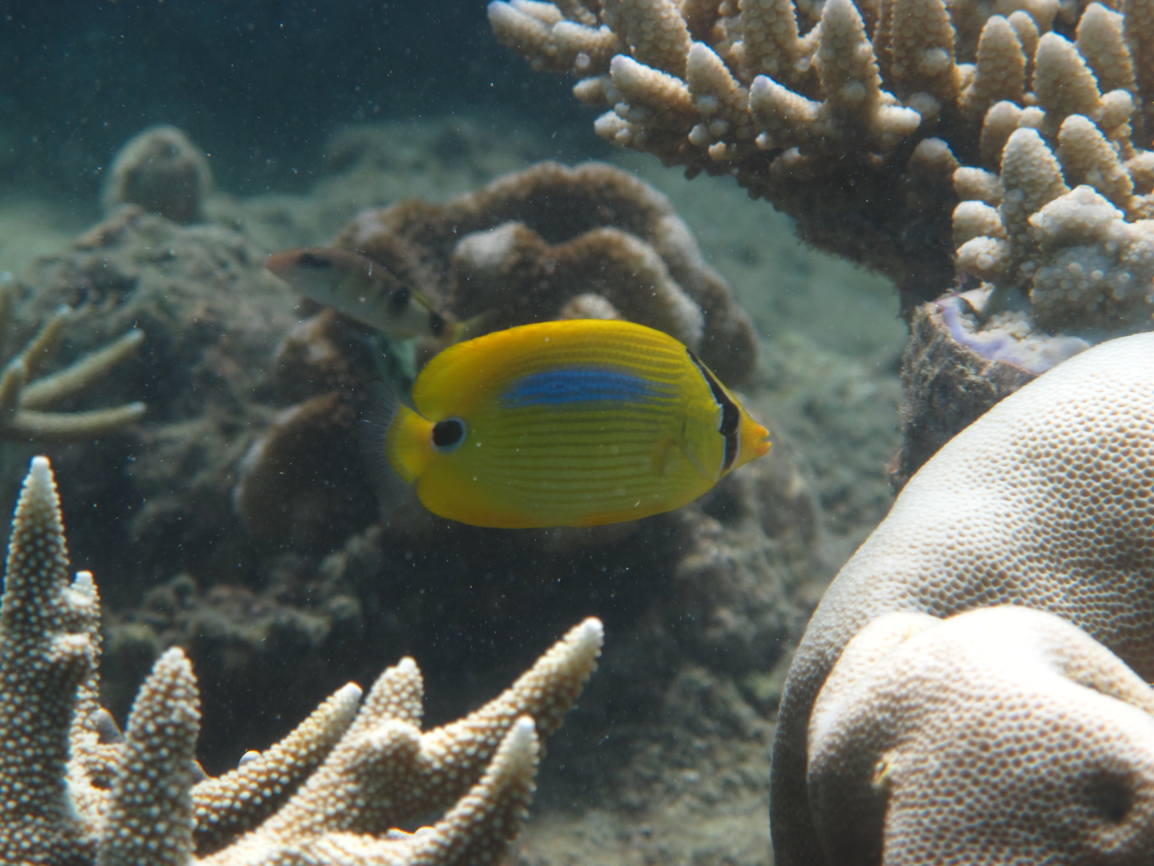
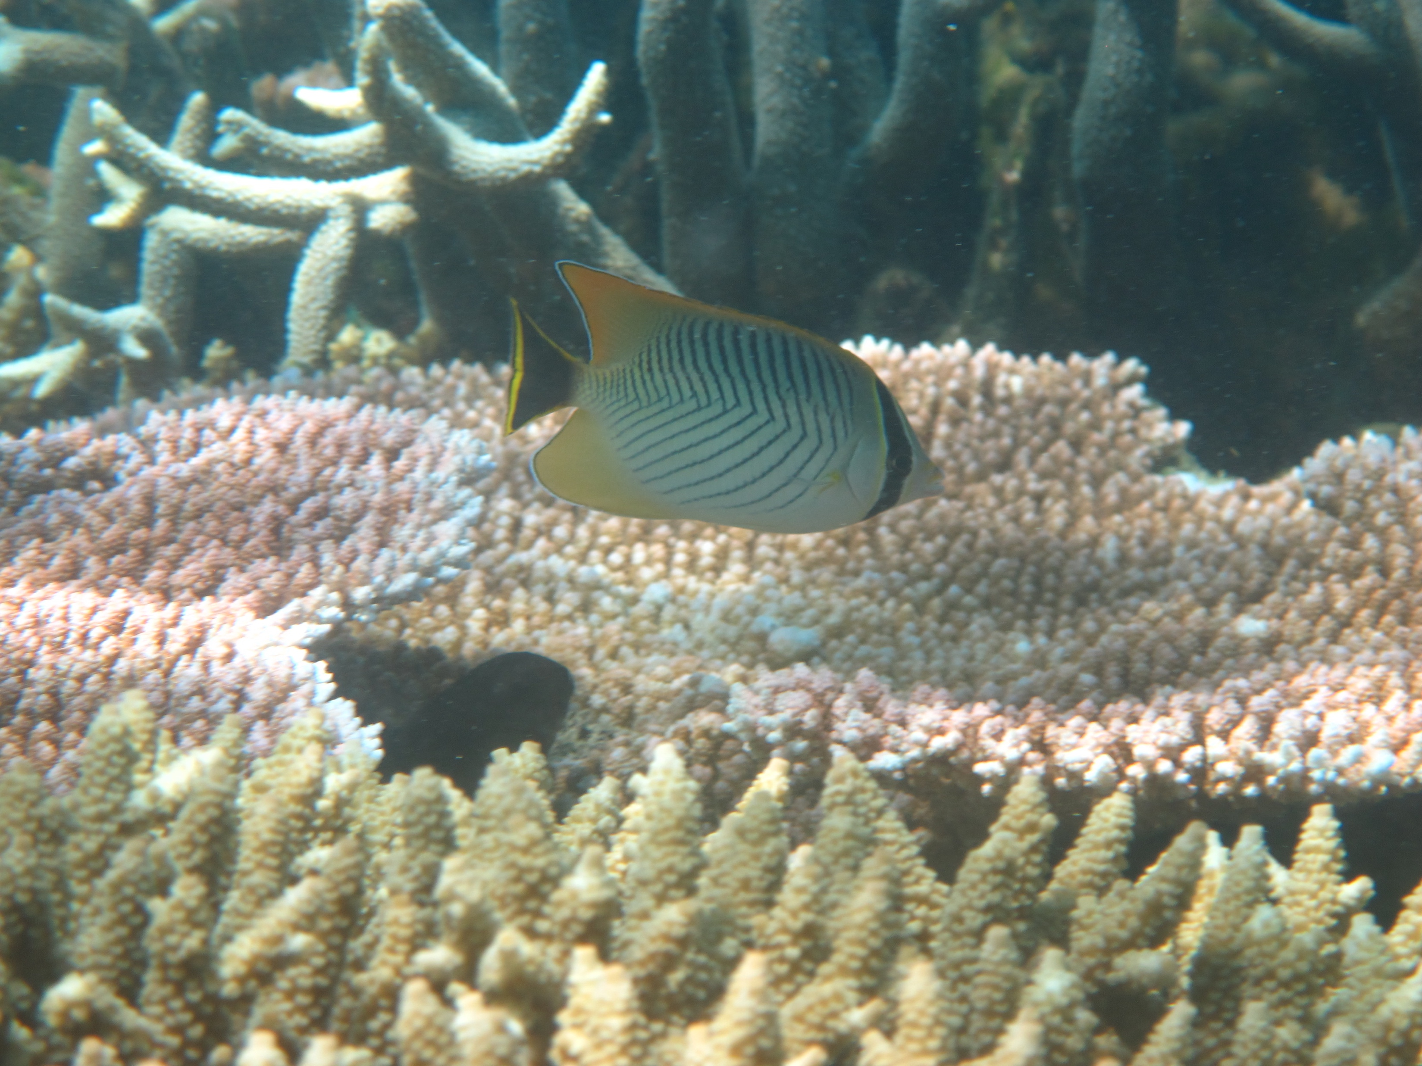
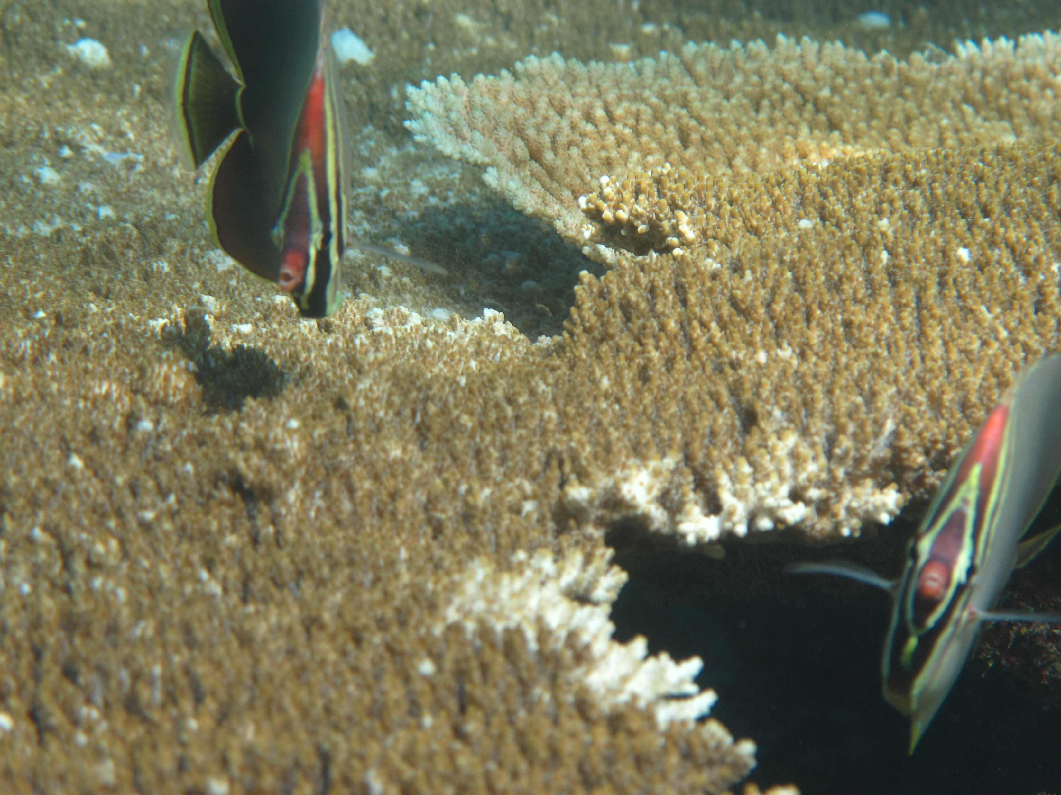
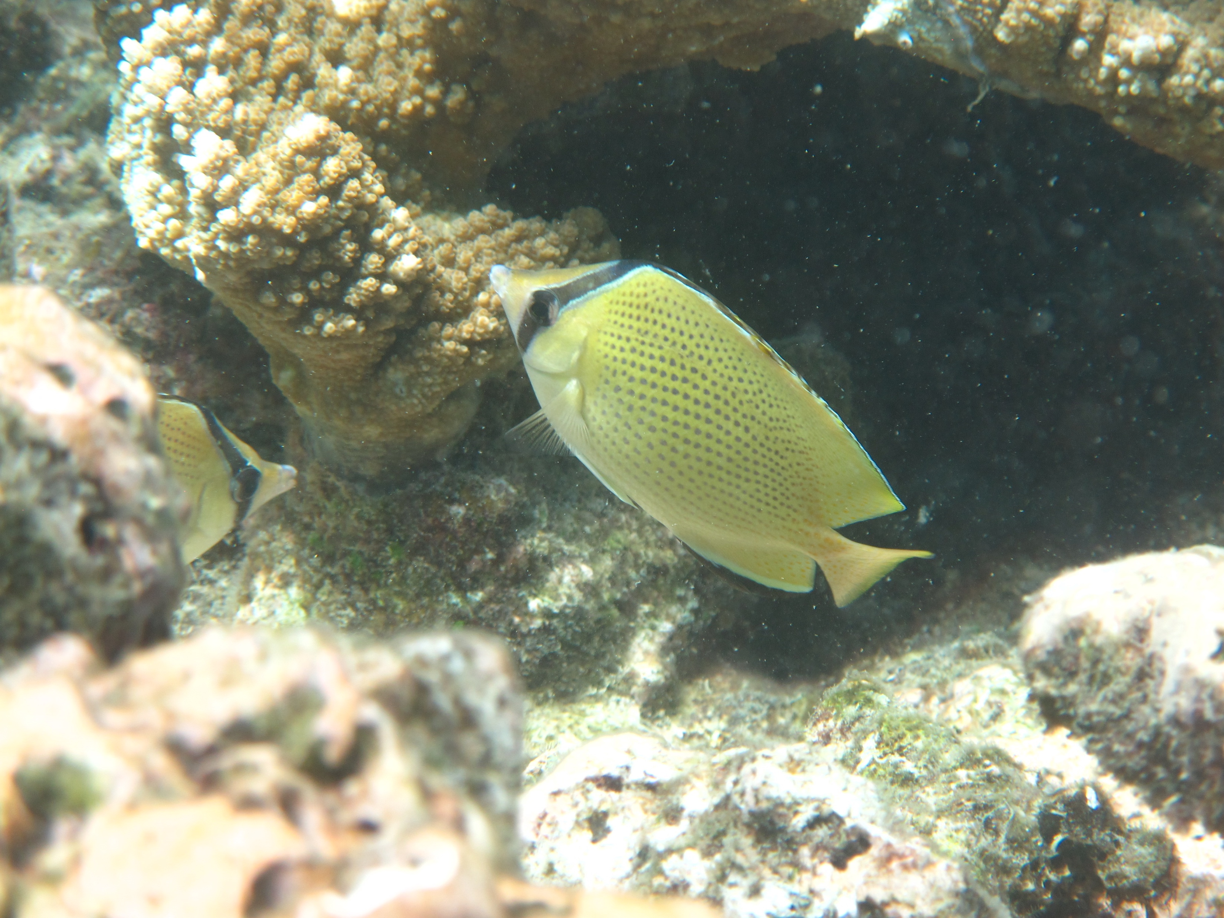
Recap I: what is biodiversity?

Slide 3
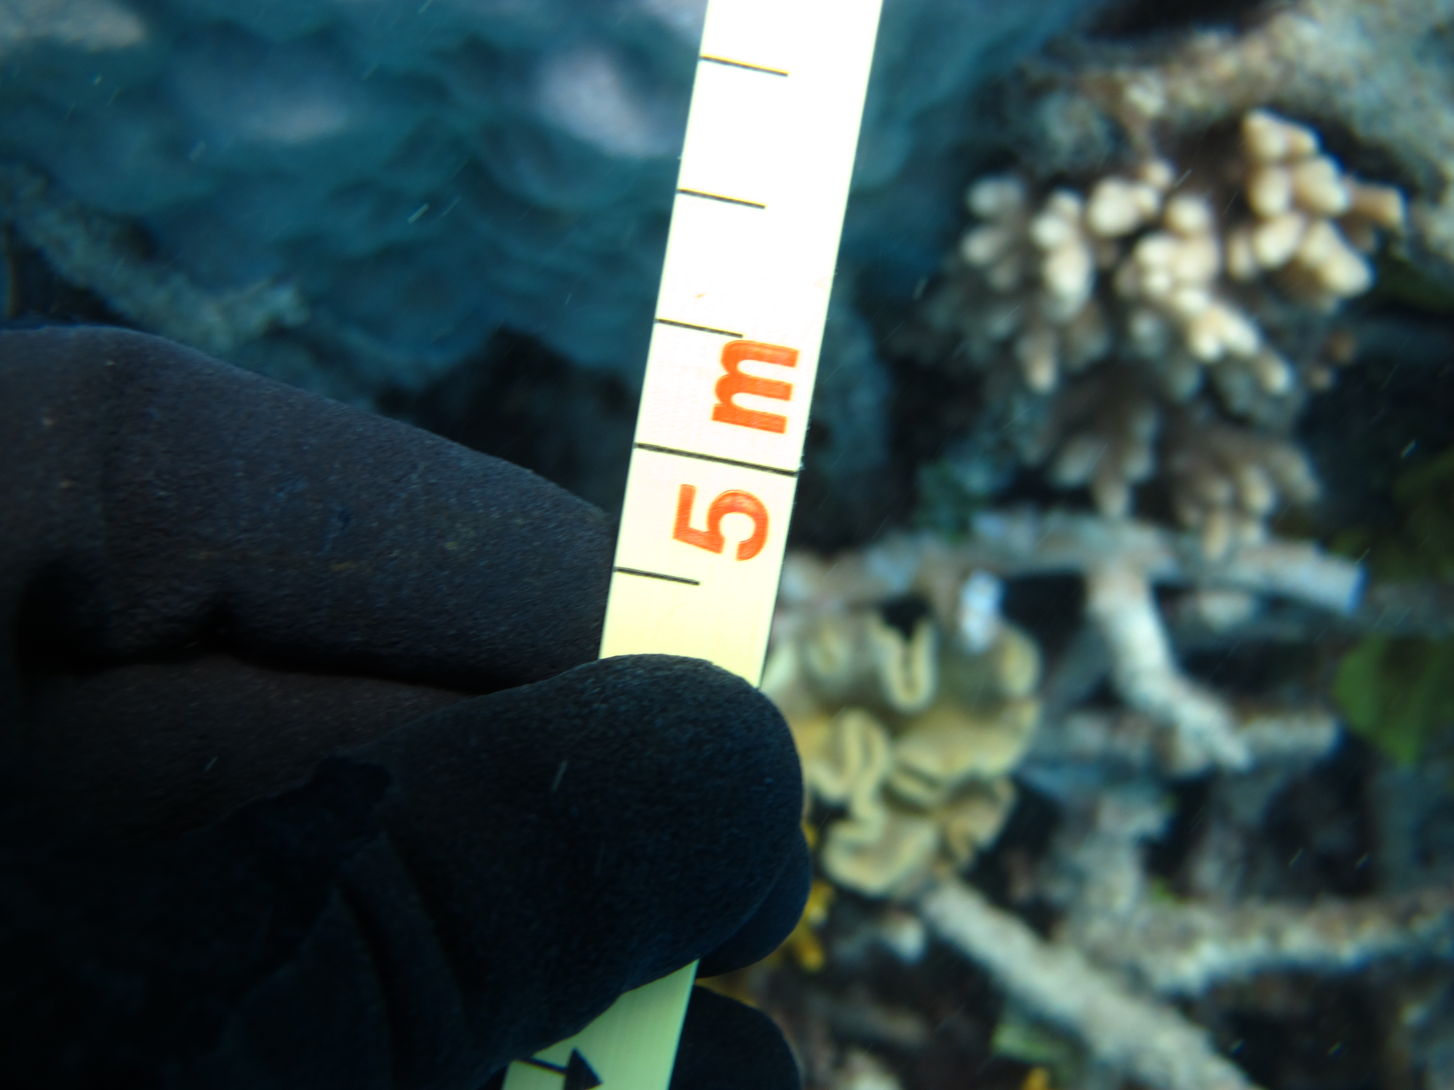
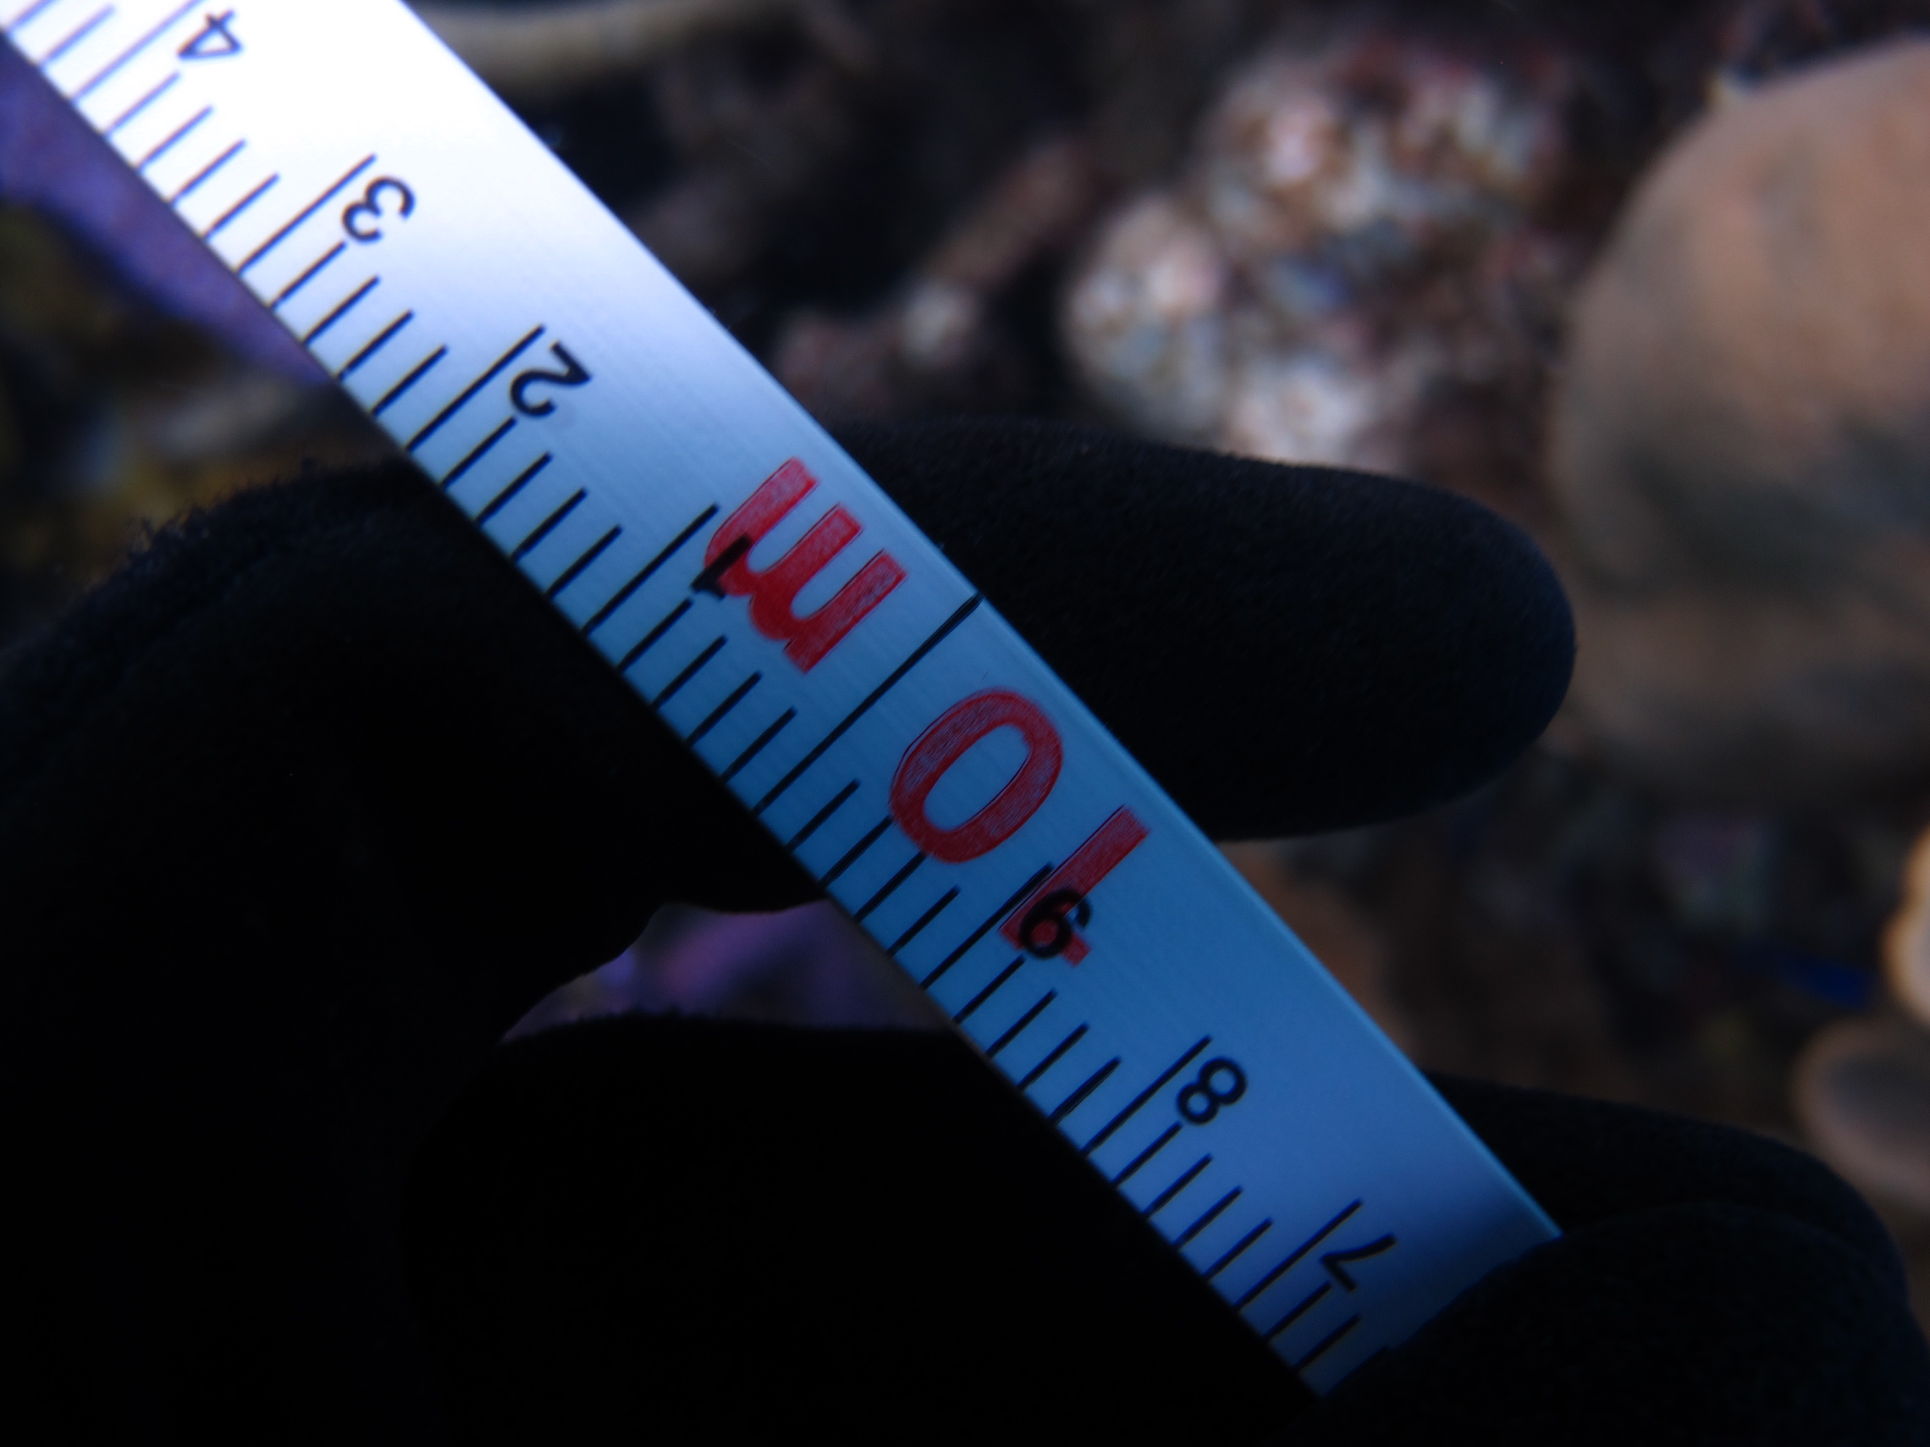
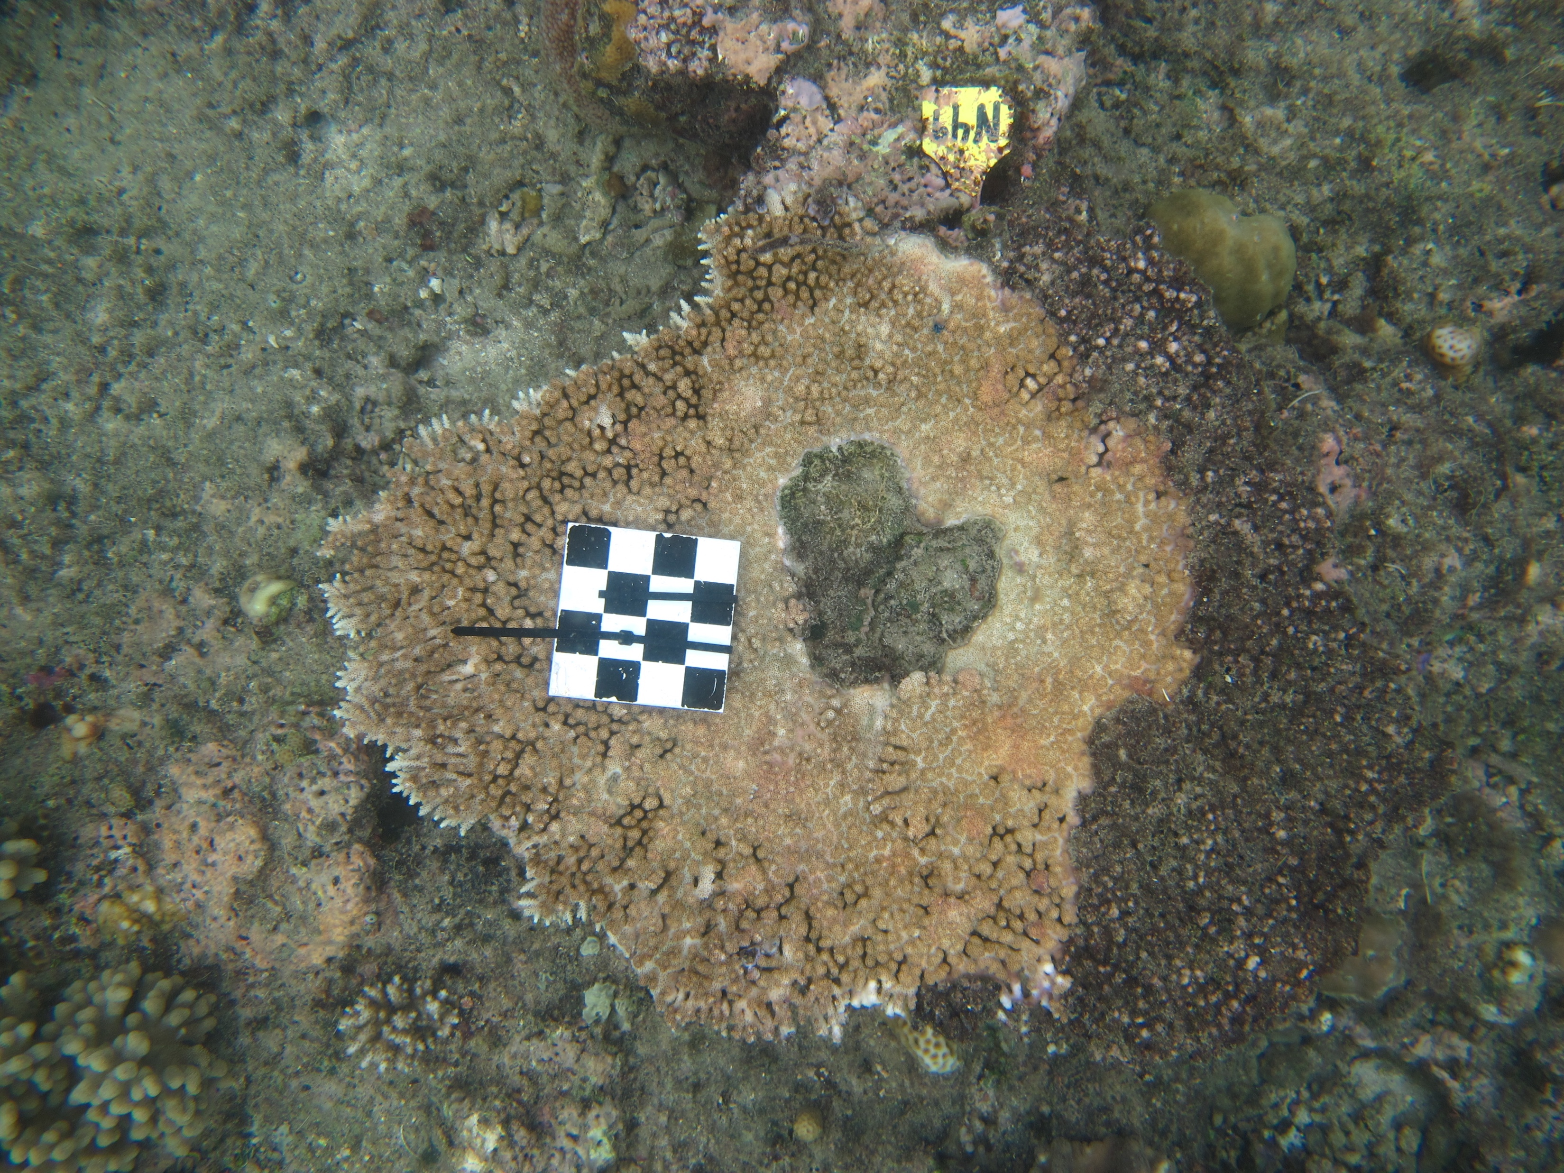
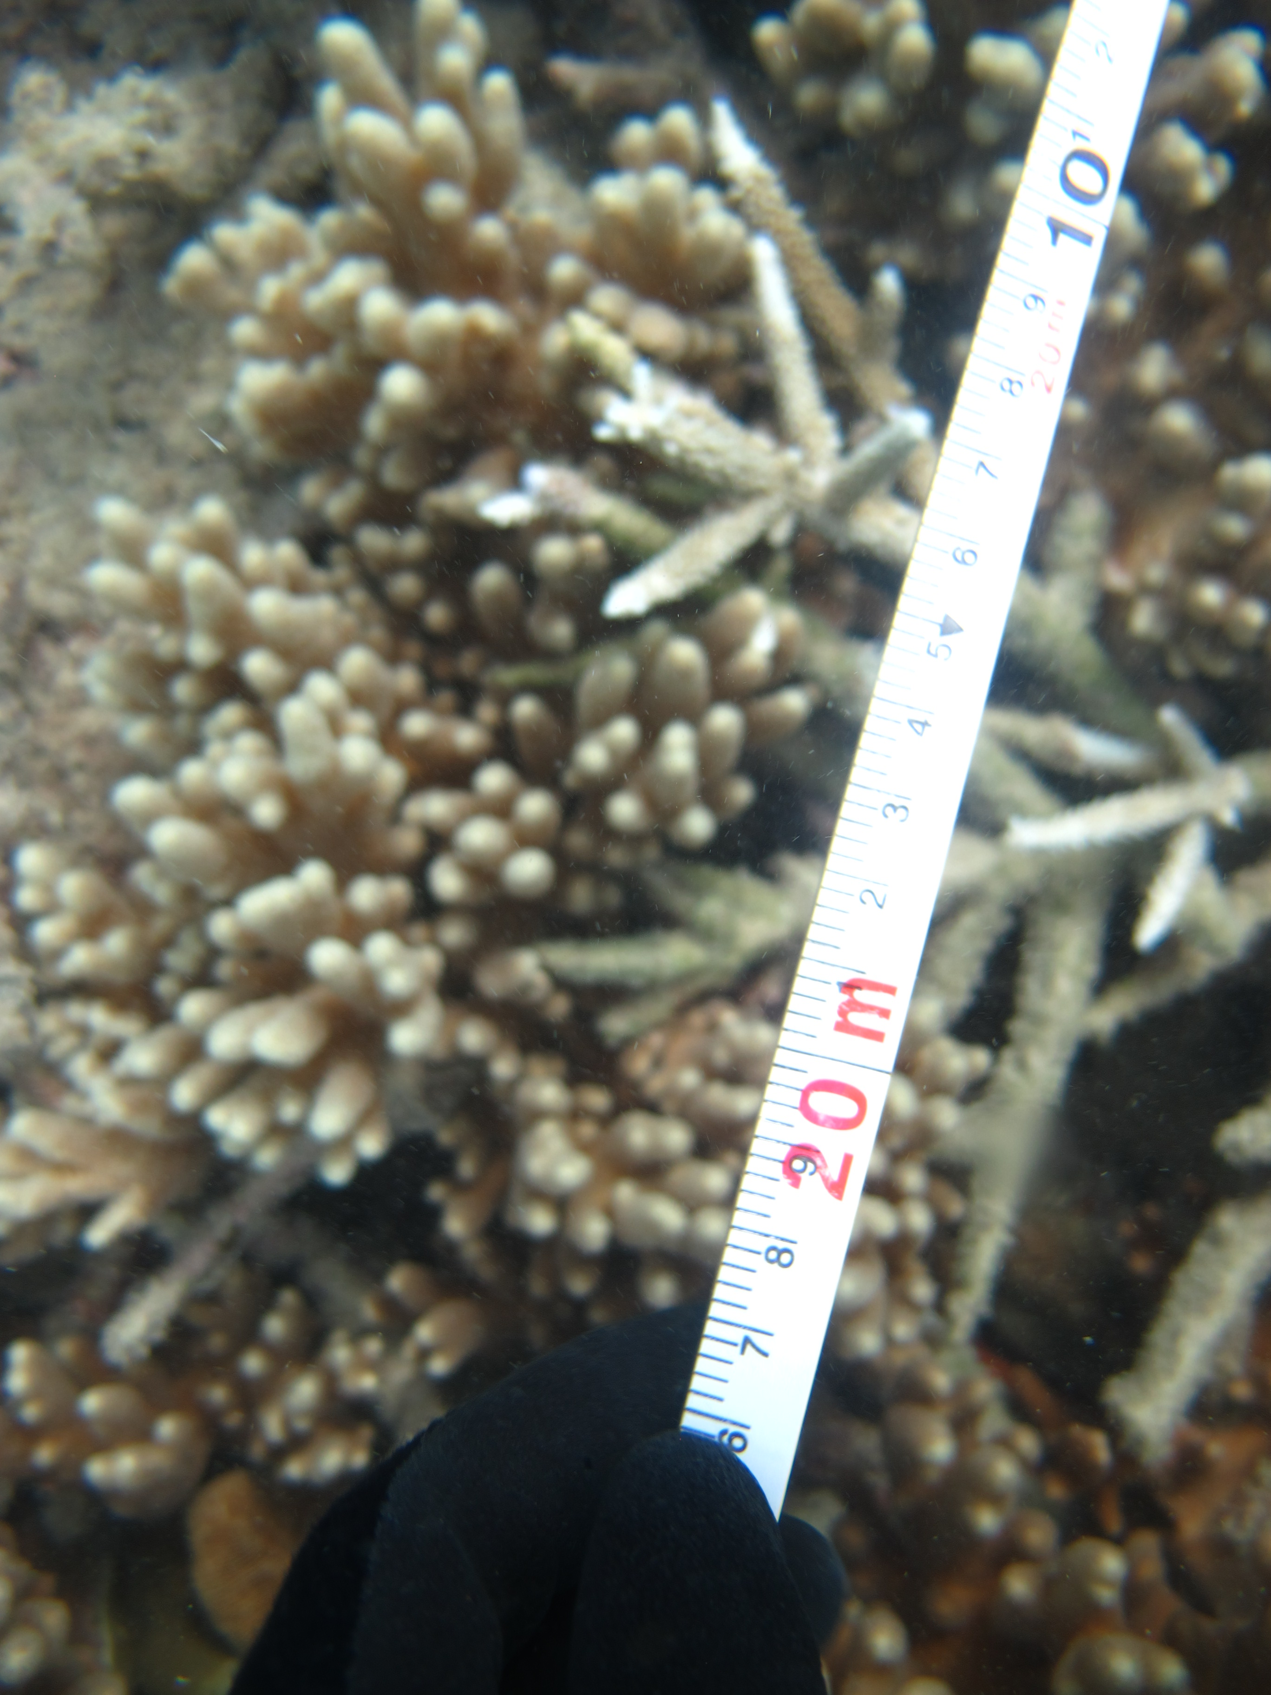
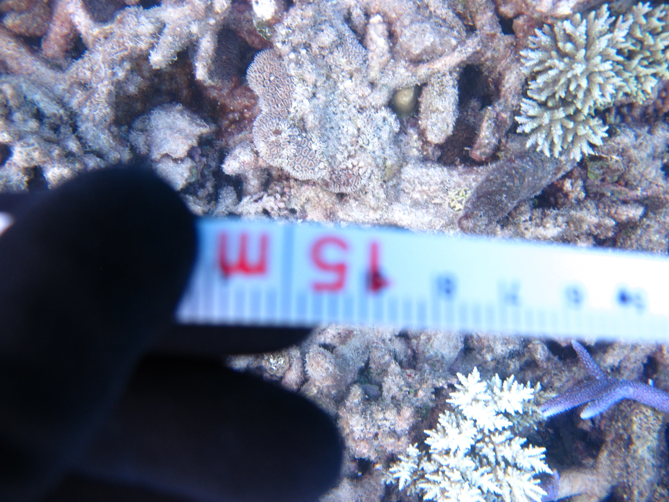
Recap II: Scale
Why? Types?

Slide 4
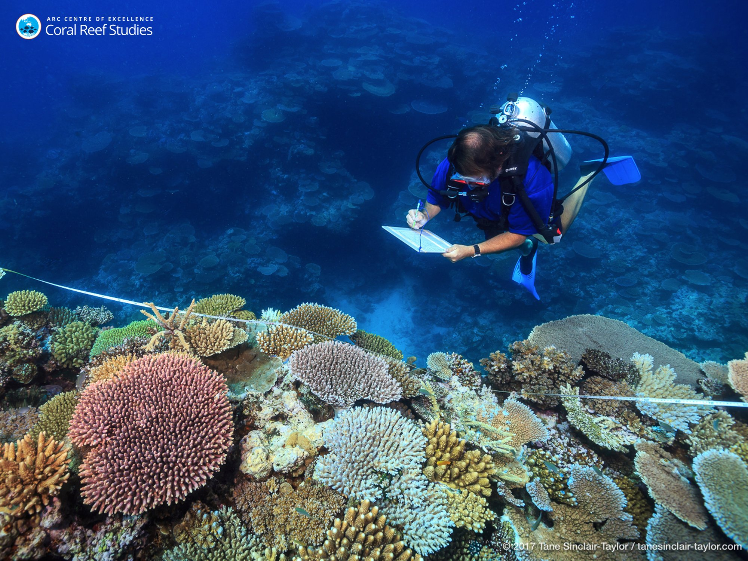
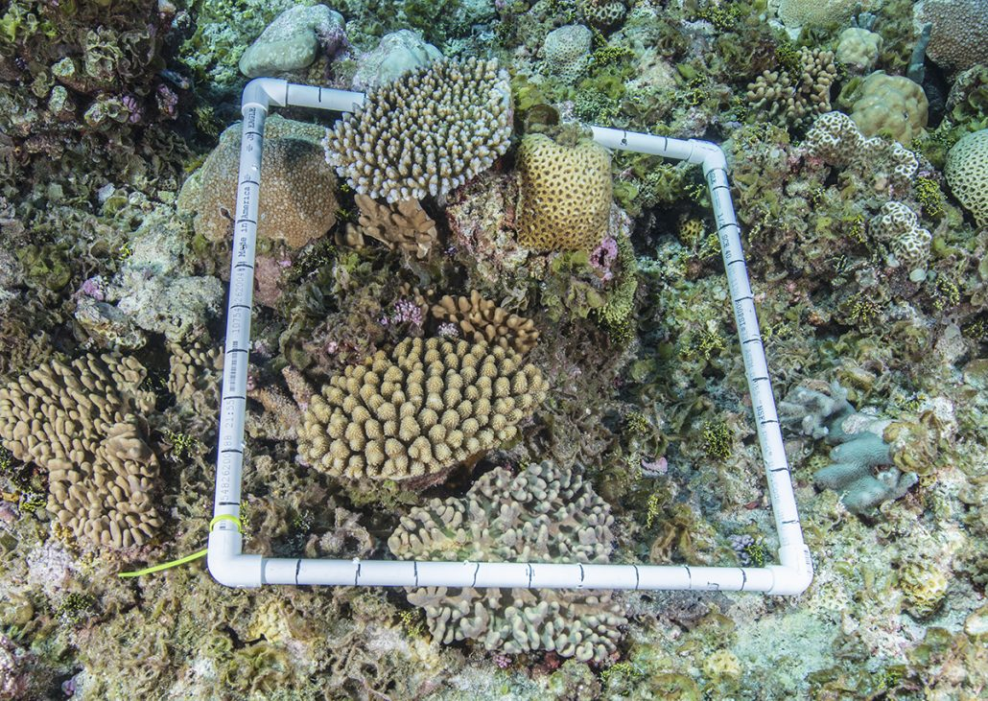
How to measure biodiversity?
Typically starts with a ‘sample’
quadrat
transect

Slide 5

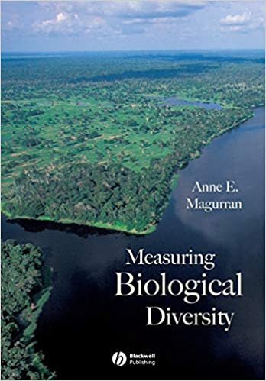
How to measure biodiversity?
Choose a metric…

Slide 6
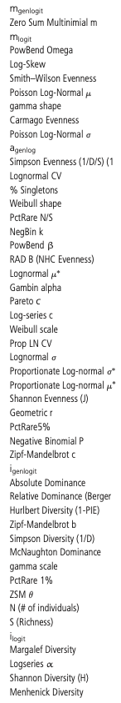
How to measure biodiversity?
Choose a metric…
…but there are a LOT of
metrics to choose from!
McGill 2011

Slide 7
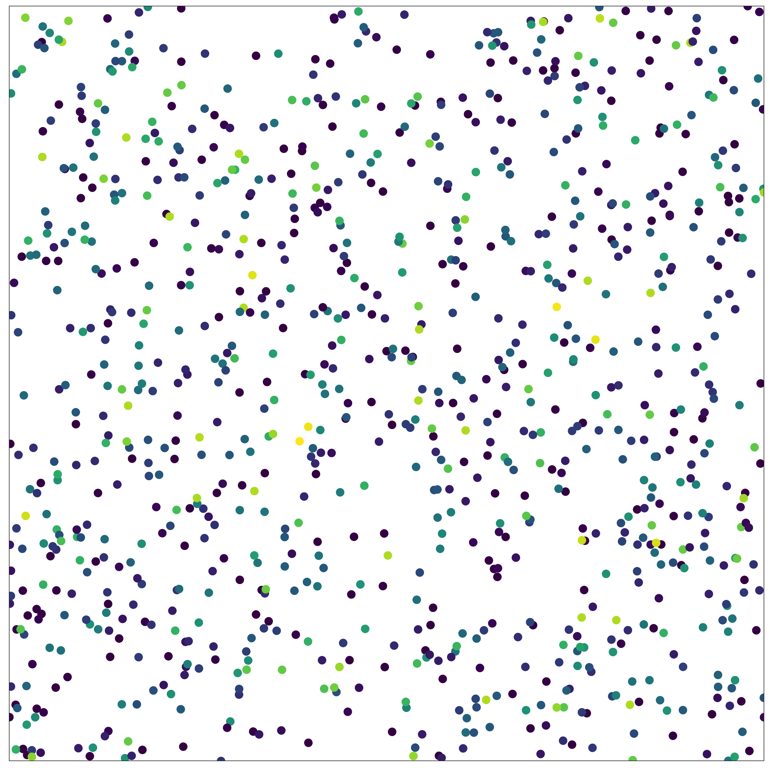
How to measure biodiversity?
Multiple components:
number of individuals (N)
relative abundance of species (evenness)
total number of species (richness)
Different metrics incorporate
these components to varying degrees, but key axes of variation are abundance, evenness and richness (McGill 2011)

Slide 8
How to measure biodiversity?
Multiple components:
number of individuals (N)
relative abundance of species (evenness)
total number of species (richness)
Different metrics incorporate
these components to varying degrees, but key axes of variation are abundance, evenness and richness (McGill 2011)
Want to use rarefaction to examine:
Component (abundance, evenness and richness) changes , and
Scale-dependent changes

Slide 9
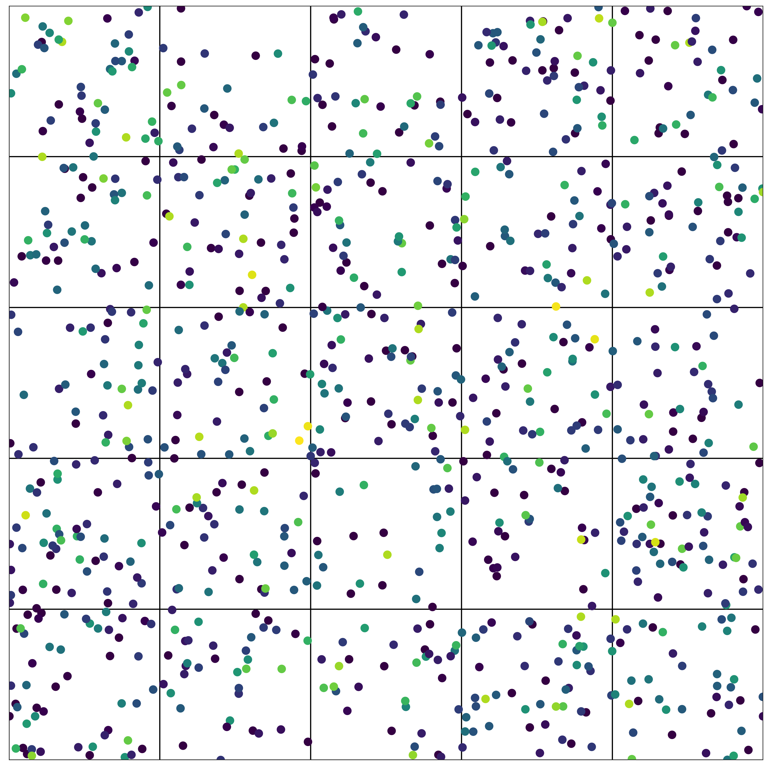
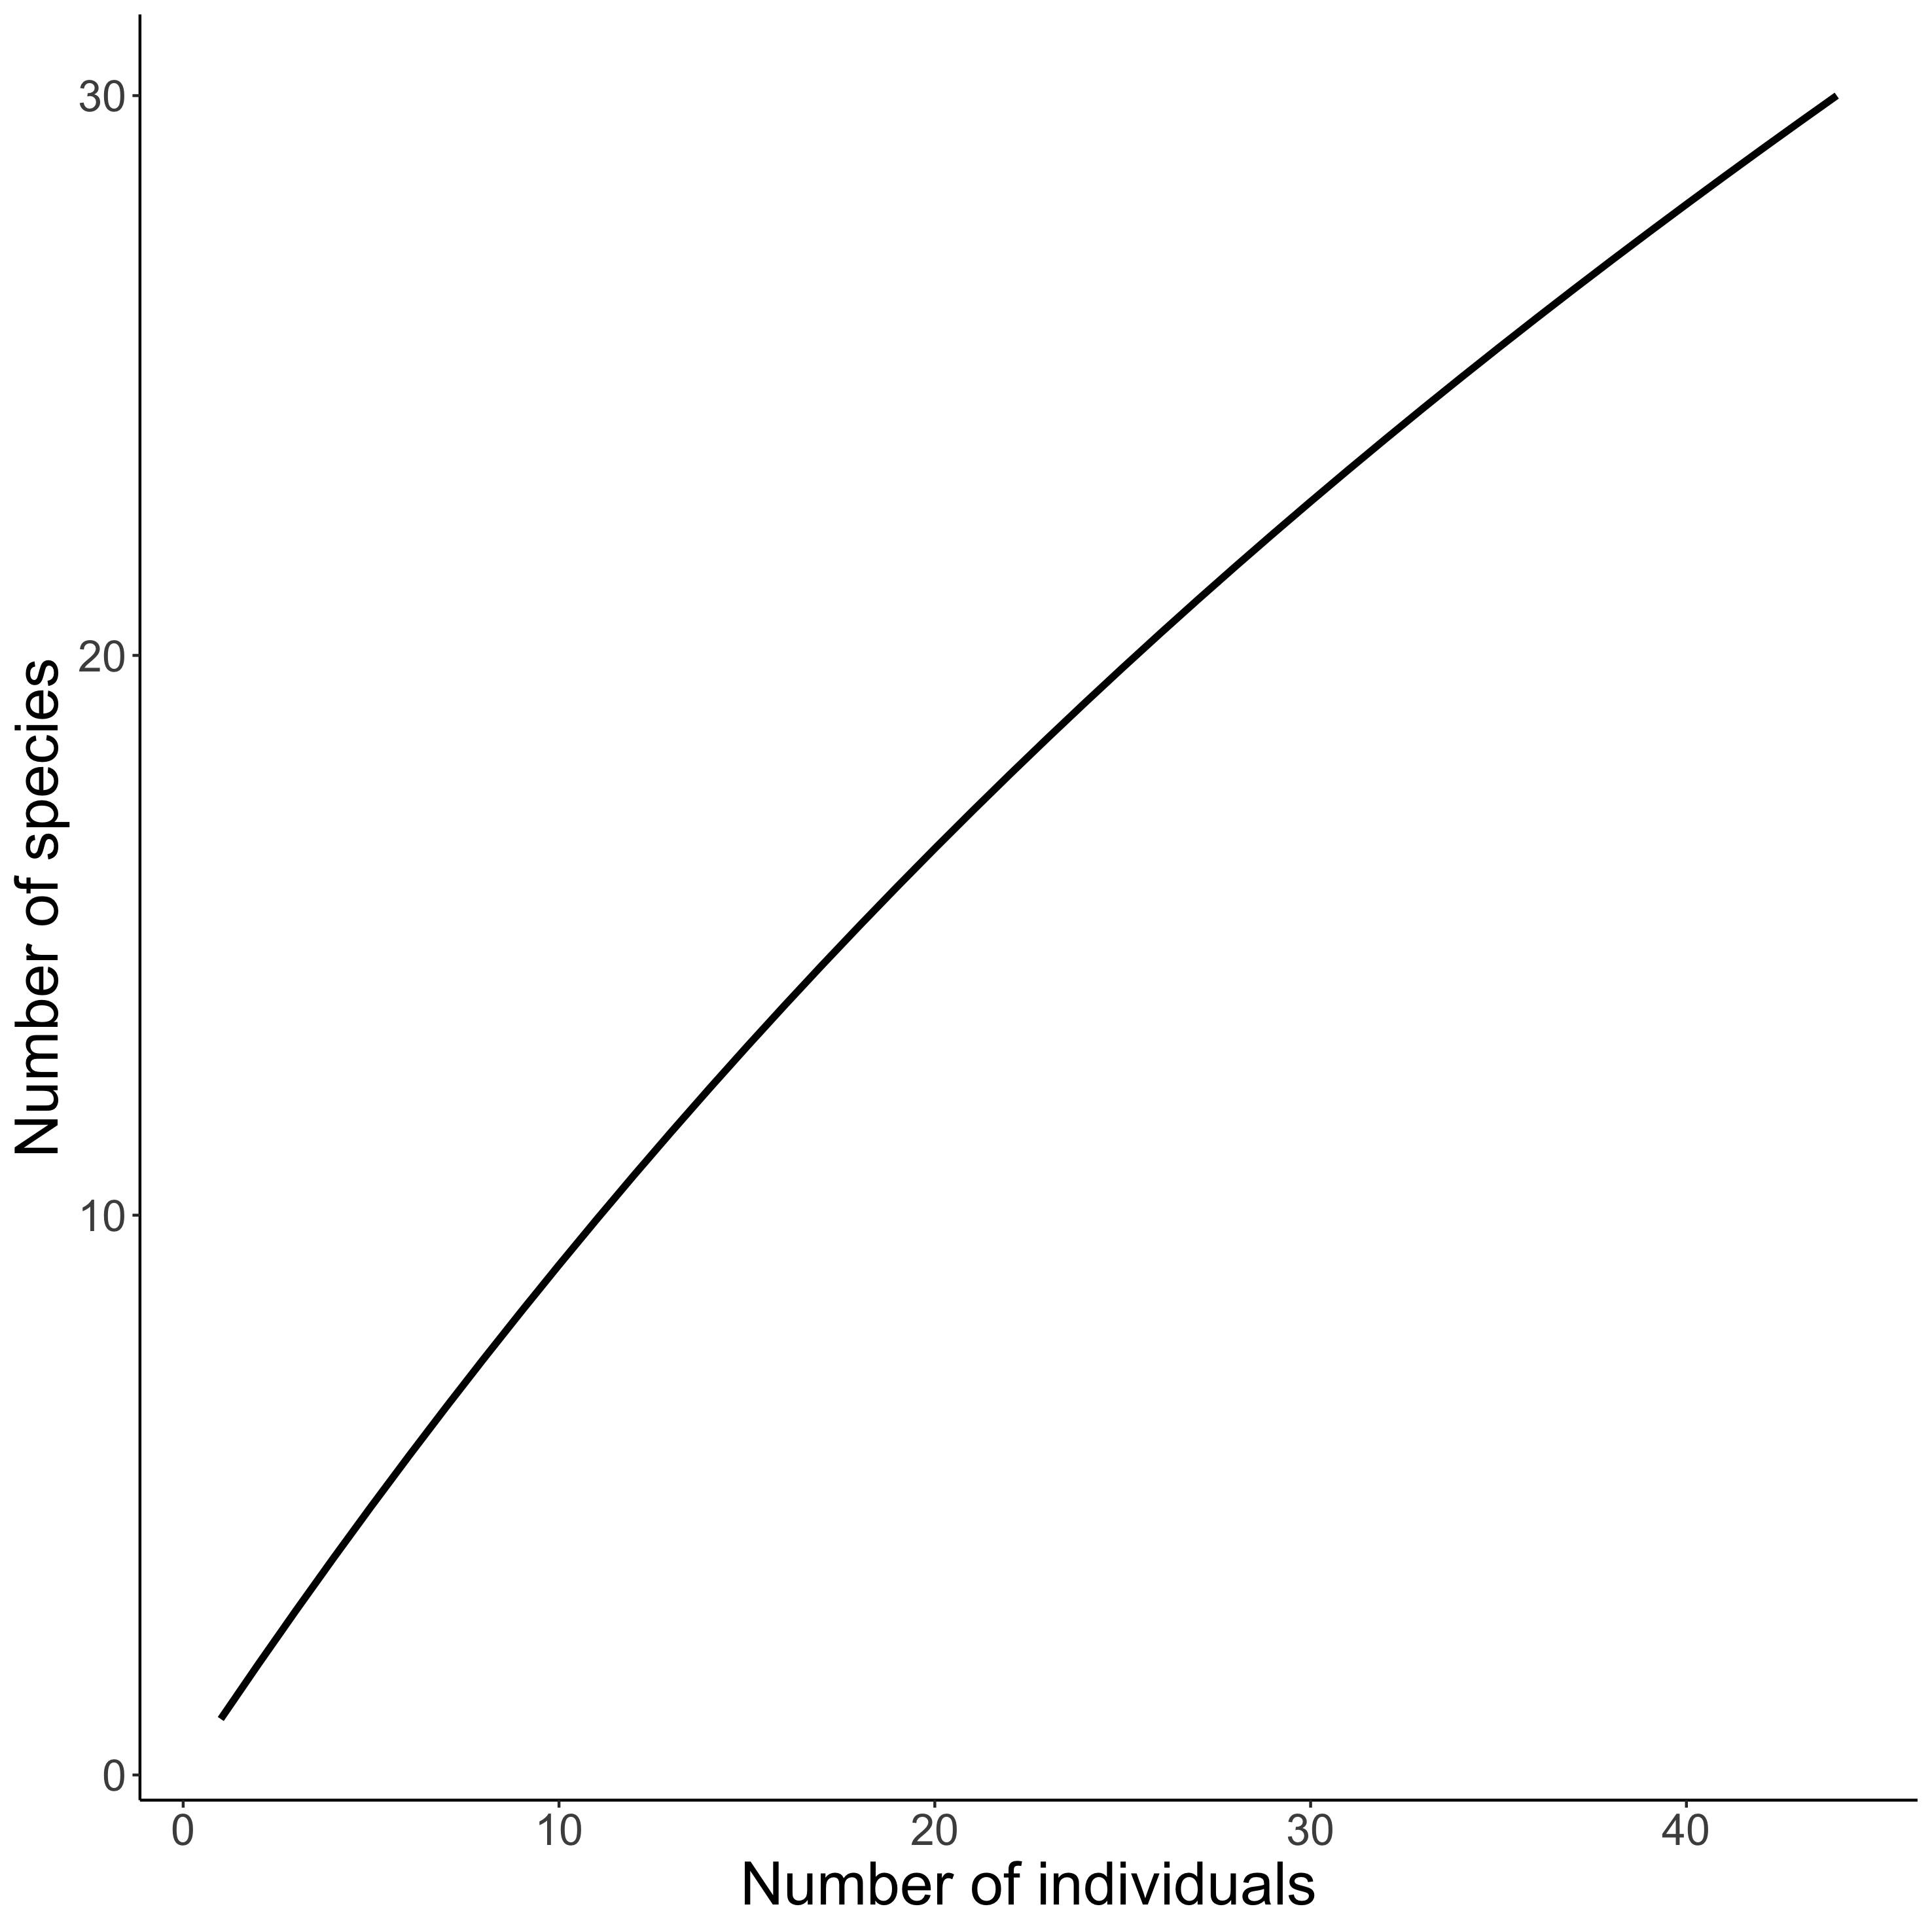
Visualising biodiversity through the lens of Individual Based Rarefaction (IBR)
𝛼-scale
Hurlbert 1971 Ecology, Gotelli & Colwell 2001 Ecol Lett

Slide 10
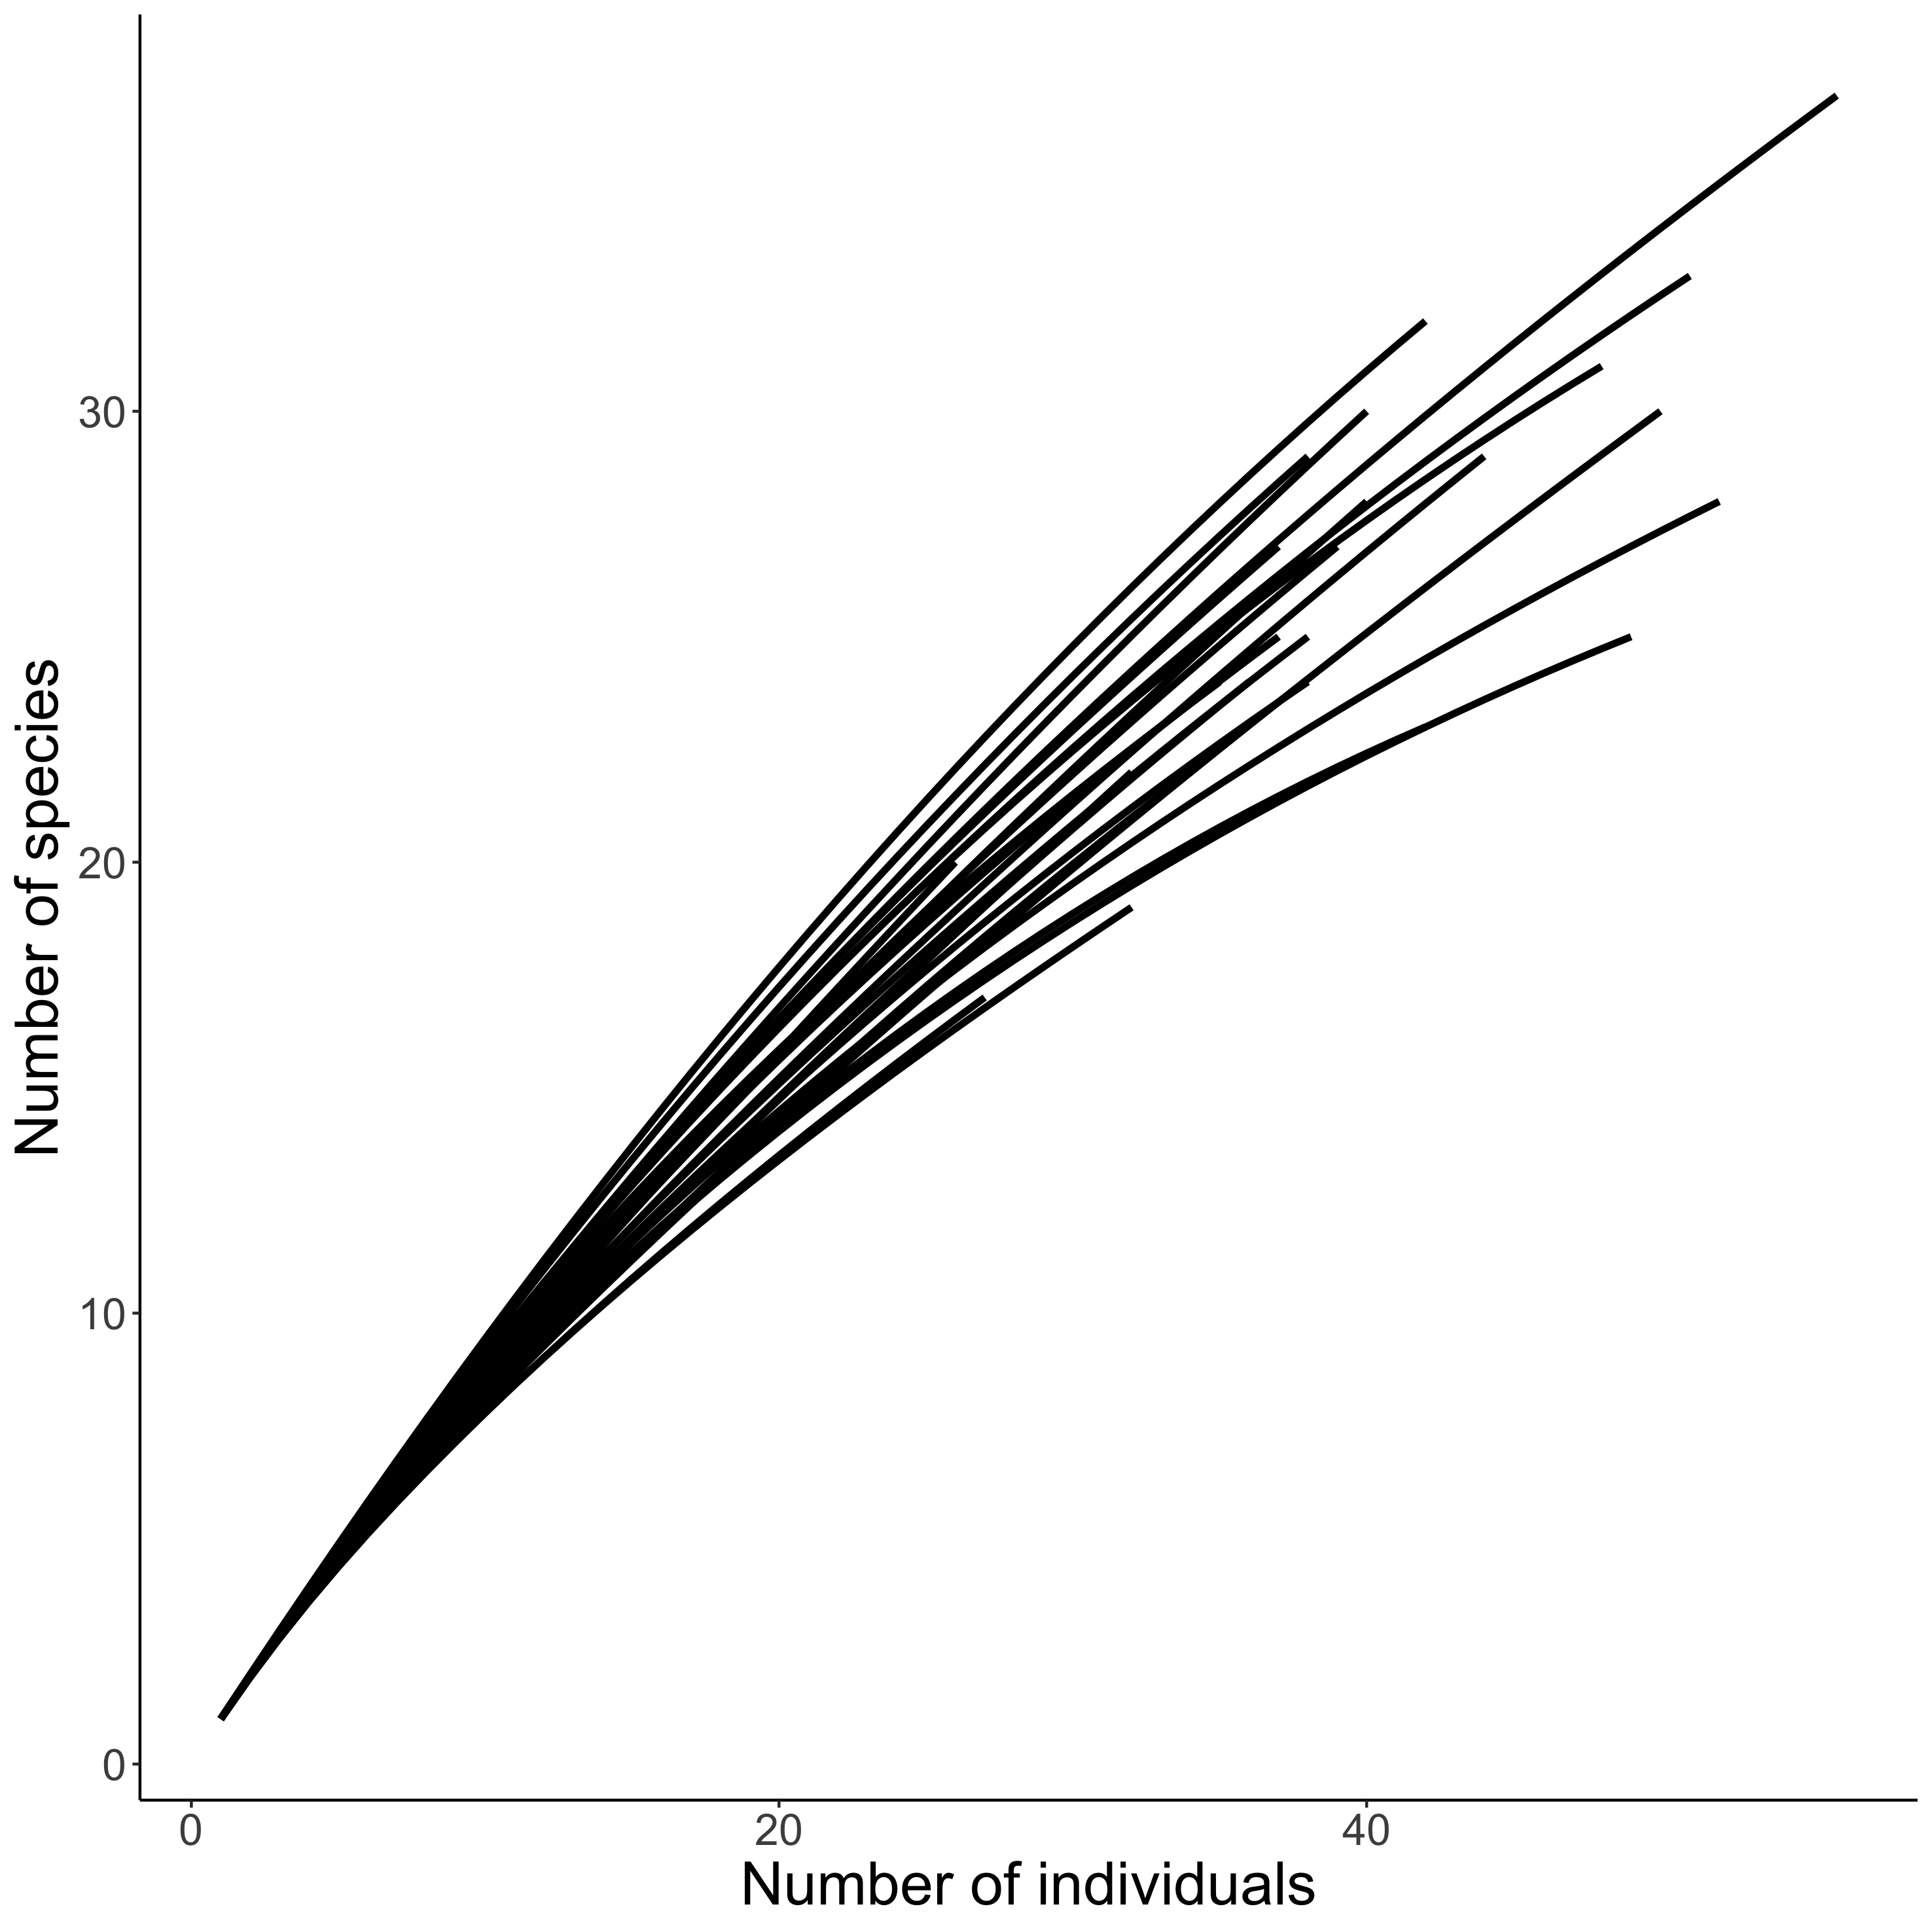
Visualising biodiversity through the lens of Individual Based Rarefaction (IBR)
𝛼-scale : each curve corresponds to one quadrat
Hurlbert 1971 Ecology, Gotelli & Colwell 2001 Ecol Lett

Slide 11
Abundance, evenness and richness with IBR
{N_{obs}, S_{obs}}
Species richness (S)
{N = 1, S = 1}
Total number of individuals (N)
Hurlbert 1971 Ecology, Olszewski 2004 OIKOS

Slide 12
Abundance, evenness and richness with IBR
{N_{obs}, S_{obs}}
Species richness (S)
Probability of Interspecific Encounter (PIE)
{N = 1, S = 1}
Total number of individuals (N)
Hurlbert 1971 Ecology, Olszewski 2004 OIKOS

Slide 13
Abundance, evenness and richness with IBR
Rarefied richness (S_{n}): expected species richness
for n individuals
{N_{obs}, S_{obs}}
{N = n, S_{n}}
Species richness (S)
{N = 1, S = 1}
Total number of individuals (N)
Hurlbert 1971 Ecology, Olszewski 2004 OIKOS

Slide 14
Abundance, evenness and richness change with IBR
∆S_{n}: expected # species (for n individuals)
∆S : number of species
∆N: number of individuals
Species richness (S)
∆ S_{PIE}: evenness of species‘ relative abundances
Hurlbert 1971 Ecology, Gotelli & Colwell 2001 Ecol Lett,
Chase et al. 2018 Ecol Lett
Total number of individuals (N)

Slide 15
Abundance, evenness and richness change with IBR
∆S_{n}: expected # species (for n individuals)
∆S : number of species
∆N: number of individuals
Species richness (S)
∆S
∆S
∆S
∆N
∆S_{n}
∆S_{PIE}
∆ S_{PIE}: evenness of species‘ relative abundances
Hurlbert 1971 Ecology, Gotelli & Colwell 2001 Ecol Lett,
Chase et al. 2018 Ecol Lett
Total number of individuals (N)

Slide 16
How can the components change?
S
Altered numbers of individuals (N)
N
∆ S
∆ S
∆ S
∆ N
∆ S_{n}
∆ S_{PIE}

Slide 17
How can the components change?
S
S
Altered numbers of individuals (N)
Species’ relative abundances change
N
N
∆ S
∆ S
∆ S
∆ N
∆ S_{n}
∆ S_{PIE}

Slide 18
How can the components change?
S
S
Rare species only
Altered numbers of individuals (N)
Species’ relative abundances change
N
N
∆ S
∆ S
∆ S
∆ N
∆ S_{n}
∆ S_{PIE}

Slide 19
How can the components change?
S
S
S
Both N and species’ relative abundances change
Altered numbers of individuals (N)
Species’ relative abundances change
N
N
N
∆ S
∆ S
∆ S
∆ N
∆ S_{n}
∆ S_{PIE}

Slide 20
How can the components change?
S
S
S
Both N and species’ relative abundances change
Altered numbers of individuals (N)
Species’ relative abundances change
N
N
N
∆ S
∆ S
∆ S
∆ N
∆ S_{n}
∆ S_{PIE}
S
N
Countervailing N & SAD changes

Slide 21
How can the components change?
S
S
S
Both N and species’ relative abundances change
Altered numbers of individuals (N)
Species’ relative abundances change
N
N
N
∆ S
∆ S
∆ S
∆ N
∆ S_{n}
∆ S_{PIE}
Many of degrees of freedom!
S
S
N
N
Countervailing N & SAD changes

Slide 22
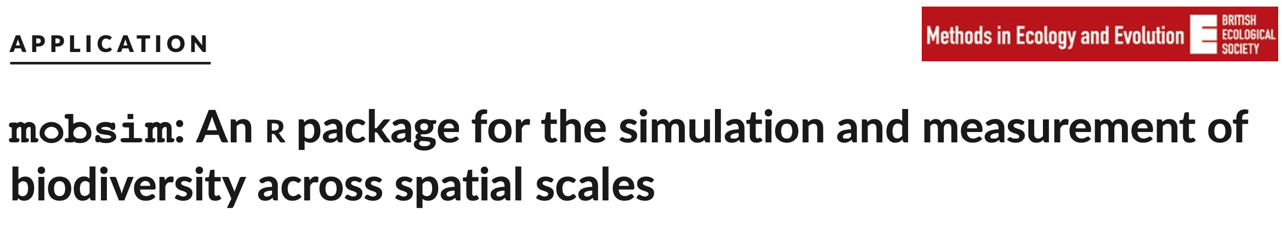
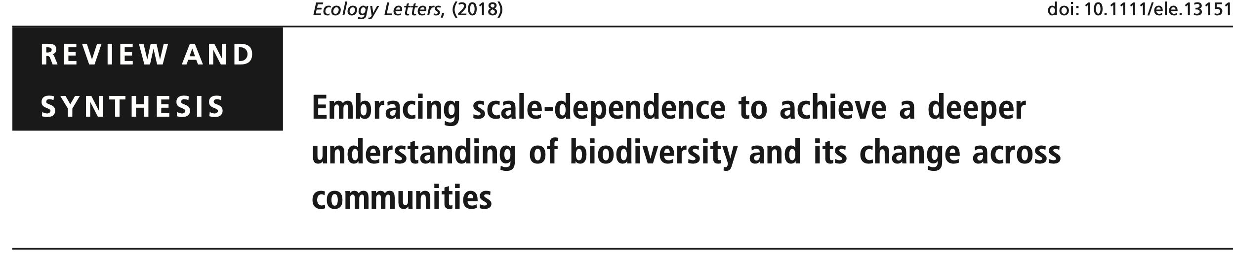
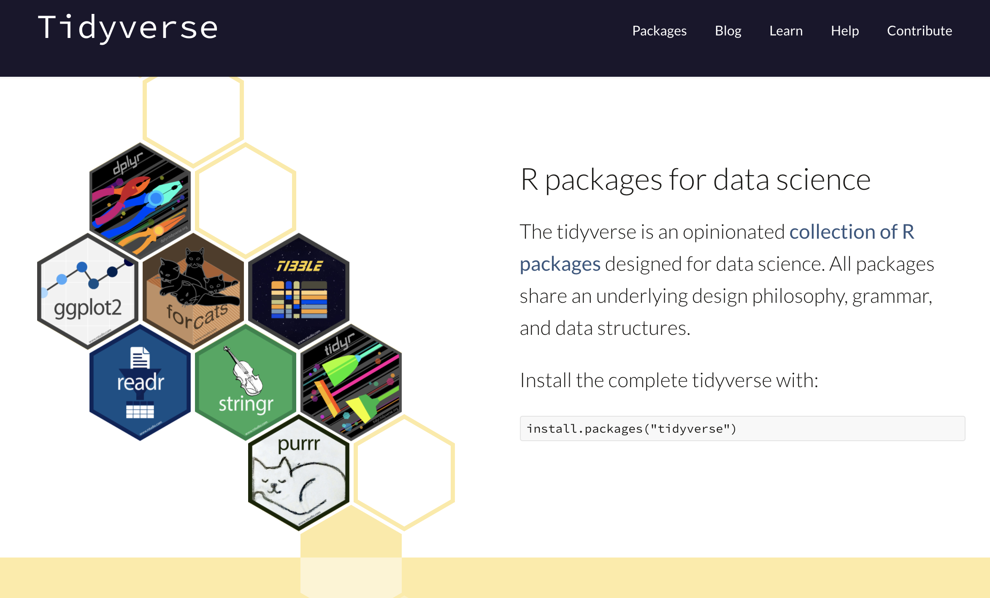
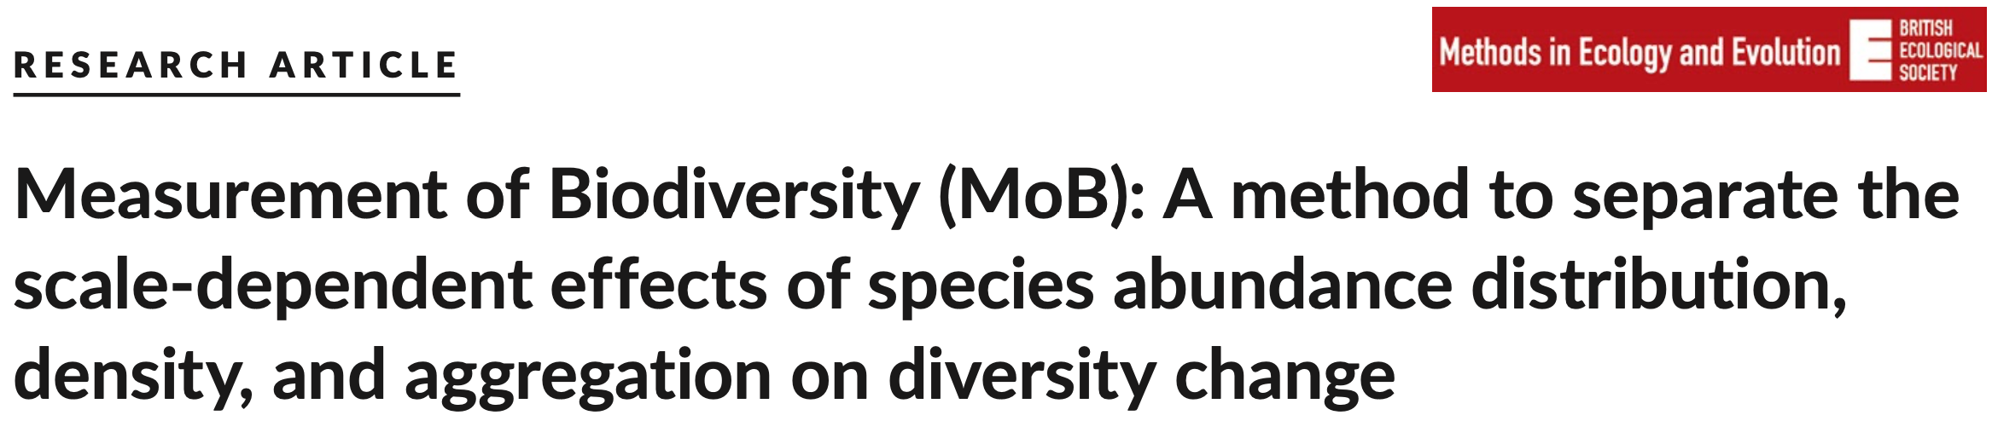
Calculating rarefaction curves, abundance, evenness and richness in R

Slide 23
How to measure biodiversity?
Multiple components:
number of individuals (N)
relative abundance of species (evenness)
total number of species (richness)
Different metrics incorporate
these components to varying degrees, but key axes of variation are abundance, evenness and richness (McGill 2011)
Want to use rarefaction to examine:
Component (abundance, evenness and richness) changes , and
Scale-dependent changes

Slide 24
Visualising biodiversity through the lens of Individual Based Rarefaction (IBR)
𝛼-scale
Hurlbert 1971 Ecology, Gotelli & Colwell 2001 Ecol Lett

Slide 25
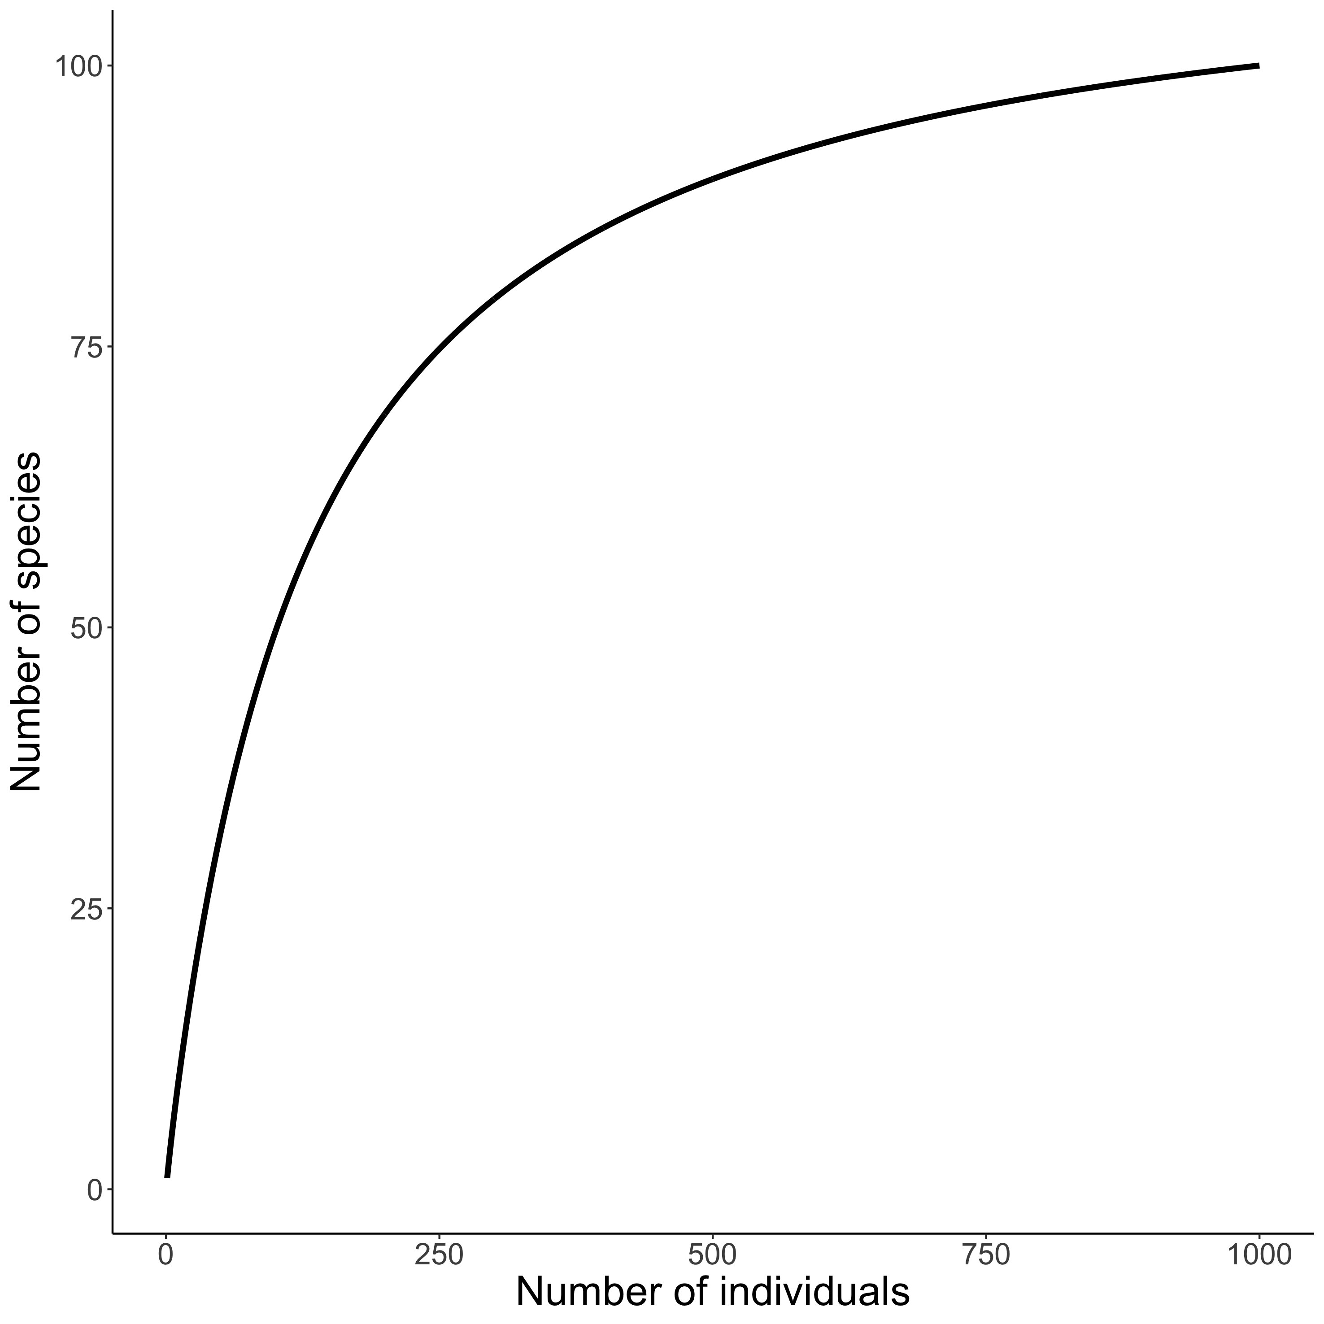
Visualising biodiversity through the lens of Individual Based Rarefaction (IBR)
𝛾-scale
Hurlbert 1971 Ecology, Gotelli & Colwell 2001 Ecol Lett

